Slide 1



Add: 12/16, 3rd floor, Ashok Nagar, New Delhi-110018 (INDIA)
Ph. : +91 11 2598 1265, M :+91 99996 56979
E-mail : safetyhouse7@gmail.com, safetyhouse7@yahoo.com
TIN No. : 07120419737, PAN No.AZRPK7108B
CLIENT : ………………
CE Certified products
Safety House
BS EN ISO 9001 : 2008 CERTIFIED COMPANY
House of all Safety Products

Slide 2

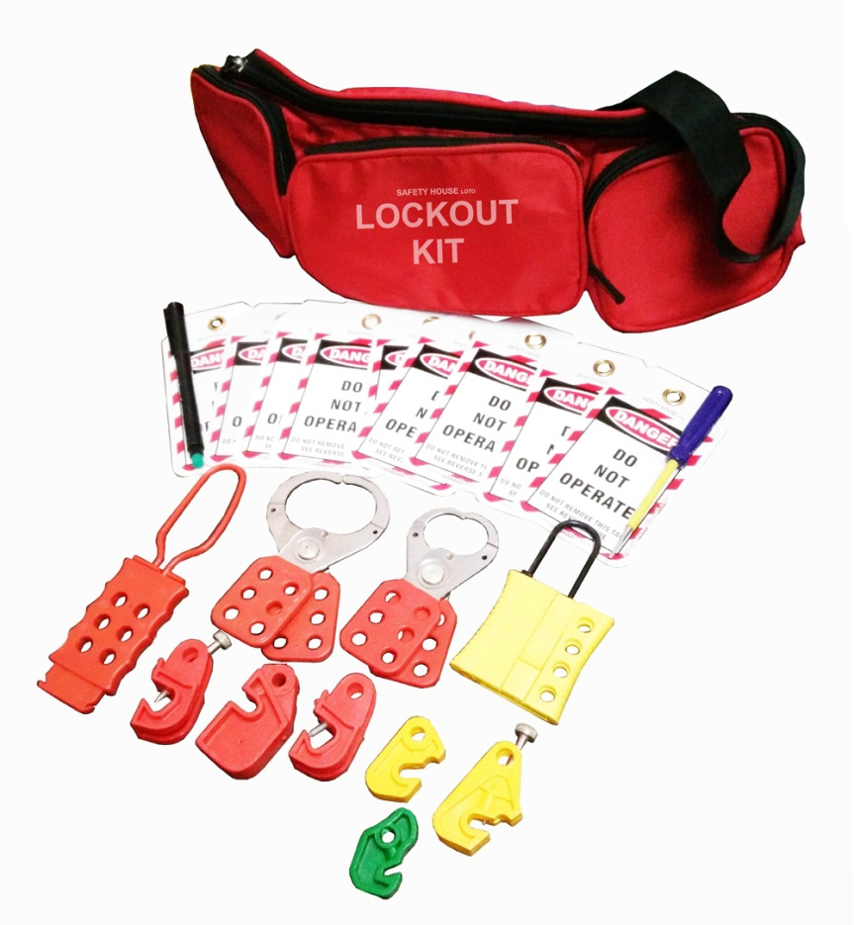
Safety House
BS EN ISO 9001 : 2008 CERTIFIED COMPANY
House of all Safety Products
CE Certified products
Item code - SH-Waist-Pouch-3P-Kit-1 –- Rs.1,771/- MRP-3,542/-
Lockout Waist Pouch having 3 pocket - Red - 1 pc
Lockout Tag – 10 pcs
Dielectric OSHA Padlock – 2 pcs.
Vinyl coated Hasp – Small – 1 pc
Vinyl coated Hasp – Premier – 1 pc
Dielectric Hasp with 6 holes – 1 pc
Slider Hasp with 4 holes – 1 pc
MCB Lockout different models – 6 pcs.
Screw Driver – 1 pc
Writing marker pen - 1
Add: 12/16, 3rd floor, Ashok Nagar, New Delhi-110018 (INDIA), Ph. : +91 11 2598 1265
M : +919999 656979, 99710 87519, E-mail : safetyhouse7@gmail.com, safetyhouse7@yahoo.com

Slide 3
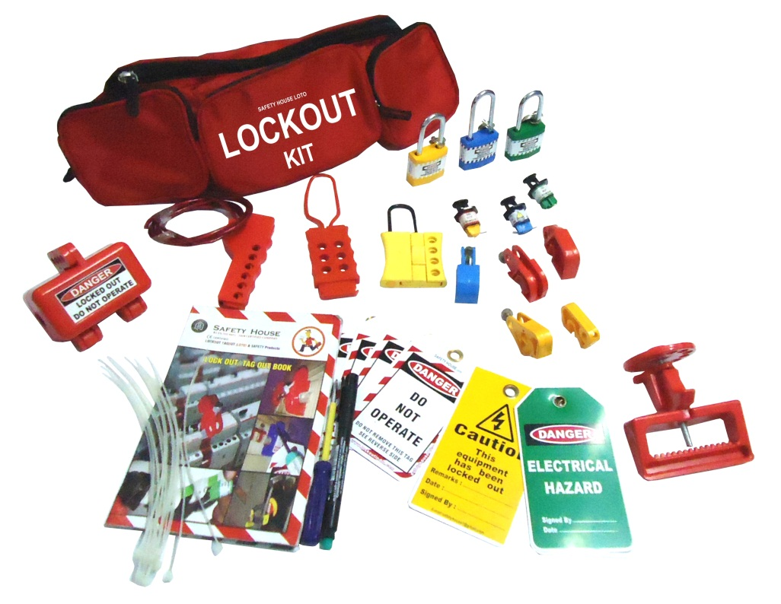
Safety House
BS EN ISO 9001 : 2008 CERTIFIED COMPANY
House of all Safety Products
CE Certified products
Item code - SH-Waist-Pouch-3P-Kit-2 – Rs.1,690/- MRP-3,380/-
Lockout Waist Pouch having 3 pocket - Red - 1 pc
Lockout Tag – 5 pcs
Lockout Guide Book – 1 pc
Dielectric Padlock – 3 pcs.
Slider Hasp with 4 holes – 1 pc
Dielectric Hasp with 6 holes – 1 pc
Plug Lockout – 1 pc
MCB Lockout different models – 5 pcs.
Pin Type MCB Lockout – 3 pcs
MCCB Lockout – 1 pc
Screw Driver – 1 pc
Writing marker pen - 1
Add: 12/16, 3rd floor, Ashok Nagar, New Delhi-110018 (INDIA), Ph. : +91 11 2598 1265
M : +919999 656979, 99710 87519, E-mail : safetyhouse7@gmail.com, safetyhouse7@yahoo.com

Slide 4
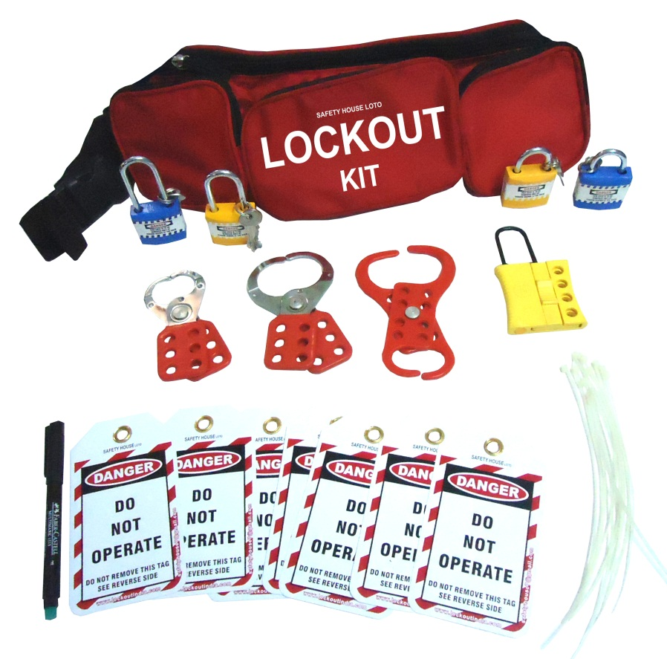
Safety House
BS EN ISO 9001 : 2008 CERTIFIED COMPANY
House of all Safety Products
CE Certified products
Item code - SH-Waist-Pouch-3P-Kit-3 – Rs.1,105/- MRP-2,210/-
Lockout Waist Pouch having 3 pocket - Red - 1 pc
Lockout Tag – 10 pcs
Dielectric Padlock – 4 pcs.
Slider Hasp with 4 holes – 1 pc
Double Jaw Hasp – 1 pc
Vinyl coated Hasp – Small – 1 pc
Vinyl coated Hasp – Premier – 1 pc
Lockout Ties – 10 pcs
Writing marker pen - 1
Add: 12/16, 3rd floor, Ashok Nagar, New Delhi-110018 (INDIA), Ph. : +91 11 2598 1265
M : +919999 656979, 99710 87519, E-mail : safetyhouse7@gmail.com, safetyhouse7@yahoo.com

Slide 5
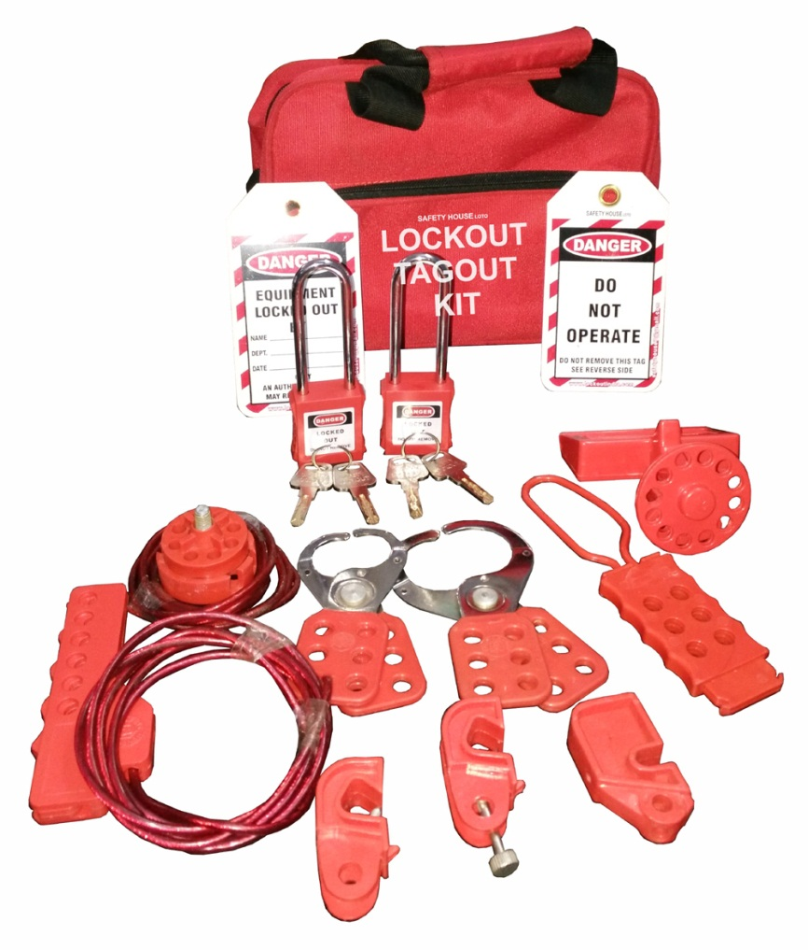
Safety House
BS EN ISO 9001 : 2008 CERTIFIED COMPANY
House of all Safety Products
CE Certified products
Item code - SH-Red-Bag-Kit-1 – Rs.1,870/- MRP-3,740/-
Lockout Bag - Red - 1 pc
Lockout Tag – 10 pcs
Dielectric OSHA Padlock with extra long shackle – 2 pcs.
Vinyl coated Hasp – Small – 1 pc
Vinyl coated Hasp – Premier – 1 pc
Dielectric Hasp with 6 holes – 1 pc
Scissor Cable Lockout– 1 pc
Top Cable Lockout – 1 pc
MCB Lockout different models – 3 pcs.
MCCB Lockout – 1 pc
Add: 12/16, 3rd floor, Ashok Nagar, New Delhi-110018 (INDIA), Ph. : +91 11 2598 1265
M : +919999 656979, 99710 87519, E-mail : safetyhouse7@gmail.com, safetyhouse7@yahoo.com

Slide 6
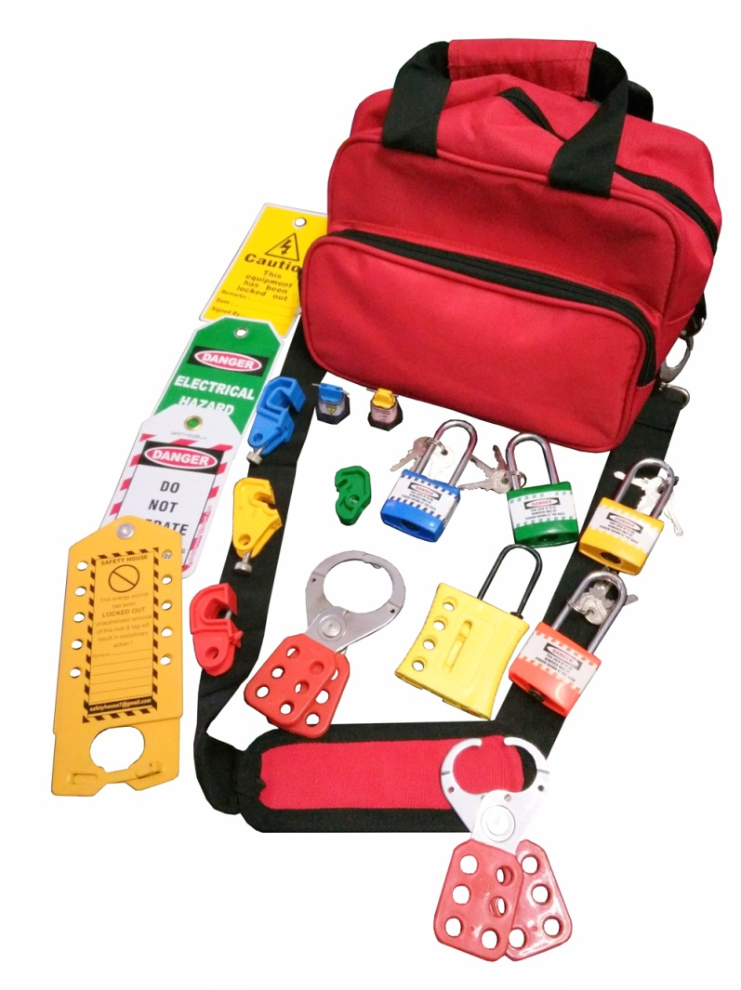
Safety House
BS EN ISO 9001 : 2008 CERTIFIED COMPANY
House of all Safety Products
CE Certified products
Item code - SH-Red-Bag-Kit-2 – Rs. 1,550/- MRP-3,100/-
Lockout Bag - Red - 1 pc
Lockout Tag – 5 pcs
Dielectric Padlock– 4 pcs.
Vinyl coated Hasp – Small – 1 pc
Vinyl coated Hasp – Premier – 1 pc
Slider Hasp with 4 holes – 1 pc
Scissor Cable Lockout– 1 pc
Pin Type Lockout – 2 pc
MCB Lockout different models - 4 pcs.
Labeled Hasp – 1 pc
Add: 12/16, 3rd floor, Ashok Nagar, New Delhi-110018 (INDIA), Ph. : +91 11 2598 1265
M : +919999 656979, 99710 87519, E-mail : safetyhouse7@gmail.com, safetyhouse7@yahoo.com

Slide 7
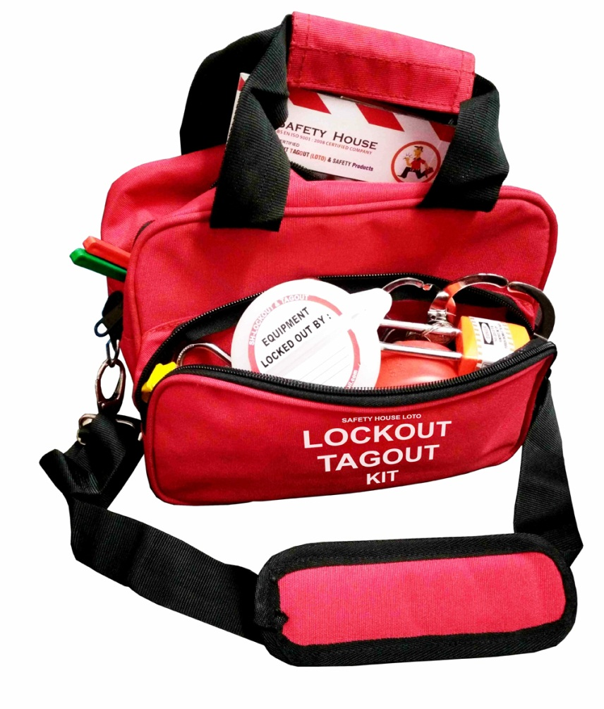
Safety House
BS EN ISO 9001 : 2008 CERTIFIED COMPANY
House of all Safety Products
CE Certified products
Item code - SH-Red-Bag-Kit-3 – Rs. 1,726/- MRP-3,500/-
Lockout Bag - Red - 1 pc
Lockout Tag – 5 pcs
Dielectric Padlock– 4 pcs.
Vinyl coated Hasp – Small – 1 pc
Vinyl coated Hasp – Premier – 1 pc
Slider Hasp with 4 holes – 1 pc
Scissor Cable Lockout– 1 pc
Pin Type Lockout – 2 pc
MCB Lockout different models - 4 pcs.
Push Button Lockout– 1 pc
Lockout Guide Book – 1 pc
Bar Type Lockout -1 pc
Add: 12/16, 3rd floor, Ashok Nagar, New Delhi-110018 (INDIA), Ph. : +91 11 2598 1265
M : +919999 656979, 99710 87519, E-mail : safetyhouse7@gmail.com, safetyhouse7@yahoo.com

Slide 8
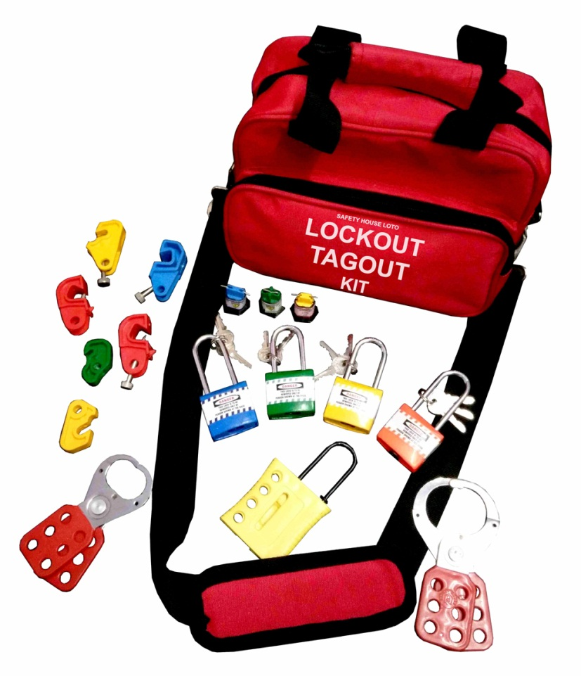
Safety House
BS EN ISO 9001 : 2008 CERTIFIED COMPANY
House of all Safety Products
CE Certified products
Item code - SH-Red-Bag-Kit-4 – Rs.1,420/- MRP-2,840/-
Lockout Bag - Red - 1 pc
Lockout Tag – 5 pcs
Dielectric Padlock– 4 pcs.
Vinyl coated Hasp – Small – 1 pc
Vinyl coated Hasp – Premier – 1 pc
Slider Hasp with 4 holes – 1 pc
MCB Lockout – different models – 6 pcs
Pin Type MCB Lockout – 3 pcs
Add: 12/16, 3rd floor, Ashok Nagar, New Delhi-110018 (INDIA), Ph. : +91 11 2598 1265
M : +919999 656979, 99710 87519, E-mail : safetyhouse7@gmail.com, safetyhouse7@yahoo.com

Slide 9
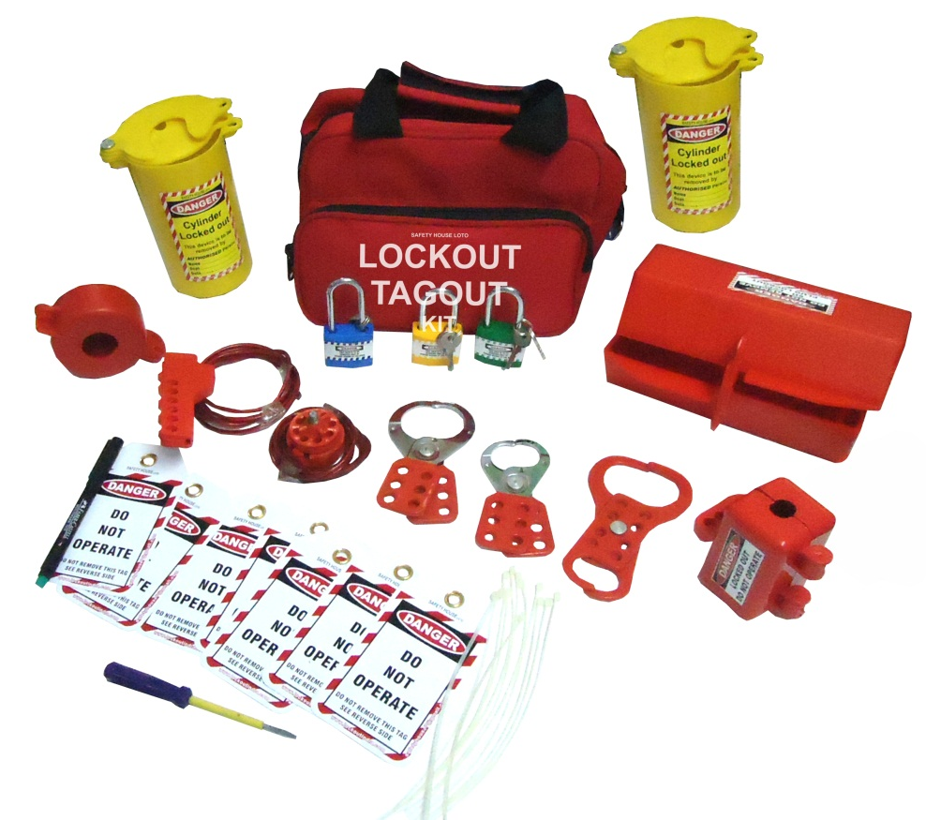
Safety House
BS EN ISO 9001 : 2008 CERTIFIED COMPANY
House of all Safety Products
CE Certified products
Item code - SH-Red-Bag-Kit-6 – Rs. 2,023/- MRP-4,046/-
Lockout Bag - Red - 1 pc
Lockout Tag – 10 pcs
Dielectric Padlock – 3 pcs.
Vinyl coated Hasp – Small – 1 pc
Vinyl coated Hasp – Premier – 1 pc
Double Jaw Hasp – 1 pc
Top Cable Lockout – 1 pc
Scissor type Cable Lockout – 1 pc
Cylinder Lockout – 2 pc
Plug Lockout – Small – 1 pc
Plug Lockout – Large – 1 pc
Gate Valve Lockout – 25-63.5mm – 1 pc
Writing pen – 1 pc
Add: 12/16, 3rd floor, Ashok Nagar, New Delhi-110018 (INDIA), Ph. : +91 11 2598 1265
M : +919999 656979, 99710 87519, E-mail : safetyhouse7@gmail.com, safetyhouse7@yahoo.com

Slide 10
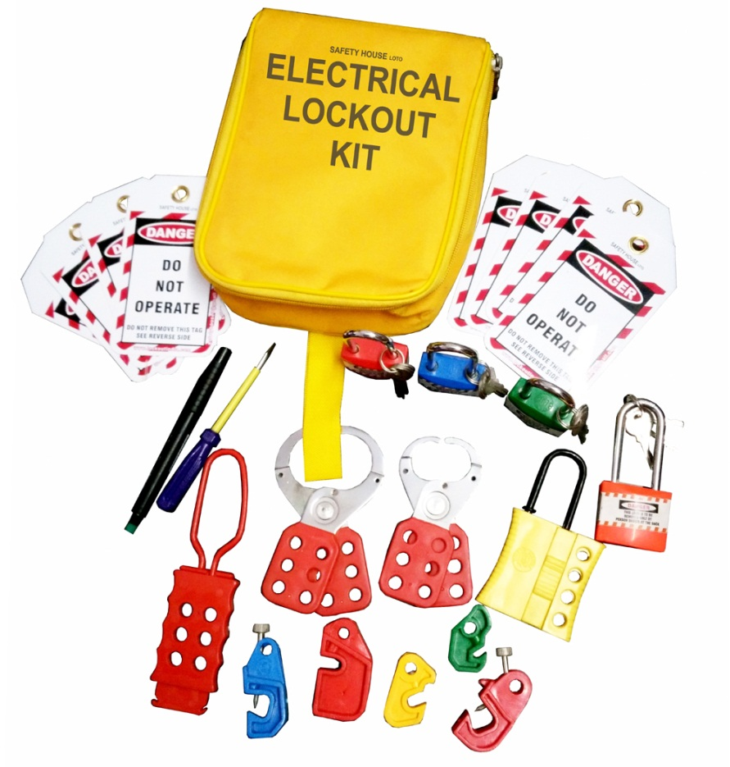
Safety House
BS EN ISO 9001 : 2008 CERTIFIED COMPANY
House of all Safety Products
CE Certified products
Item code - SH-Yellow-Bag-Kit-1 – Rs.1,192/- MRP-Rs.2,384/-
Lockout Bag - Yellow - 1 pc
Lockout Tag – 10 pcs
Dielectric Padlock– 4 pcs.
Vinyl coated Hasp – Small – 1 pc
Vinyl coated Hasp – Premier – 1 pc
Slider Hasp with 4 holes – 1 pc
MCB Lockout – different models – 5 pcs
Screw Driver – 1 pc
Writing Pen – 1 pc
Add: 12/16, 3rd floor, Ashok Nagar, New Delhi-110018 (INDIA), Ph. : +91 11 2598 1265
M : +919999 656979, 99710 87519, E-mail : safetyhouse7@gmail.com, safetyhouse7@yahoo.com

Slide 11
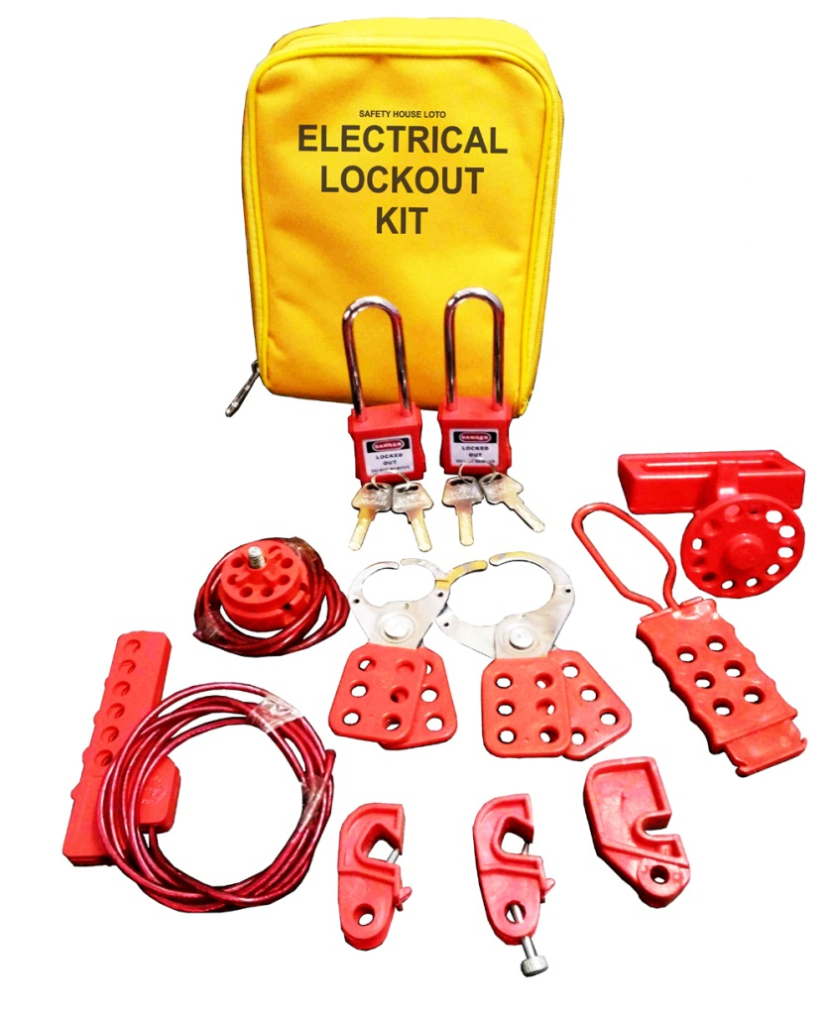
Safety House
BS EN ISO 9001 : 2008 CERTIFIED COMPANY
House of all Safety Products
CE Certified products
Item code - SH-Yellow-Bag-Kit-2 – Rs.1,762/- MRP-3,524/-
Lockout Bag - Yellow - 1 pc
Lockout Tag – 10 pcs
Dielectric OSHA Padlock with extra long shackle – 2 pcs.
Vinyl coated Hasp – Small – 1 pc
Vinyl coated Hasp – Premier – 1 pc
Dielectric Hasp with 6 holes – 1 pc
Scissor Cable Lockout– 1 pc
Top Cable Lockout – 1 pc
MCB Lockout different models – 3 pcs.
MCCB Lockout – 1 pc
Add: 12/16, 3rd floor, Ashok Nagar, New Delhi-110018 (INDIA), Ph. : +91 11 2598 1265
M : +919999 656979, 99710 87519, E-mail : safetyhouse7@gmail.com, safetyhouse7@yahoo.com

Slide 12
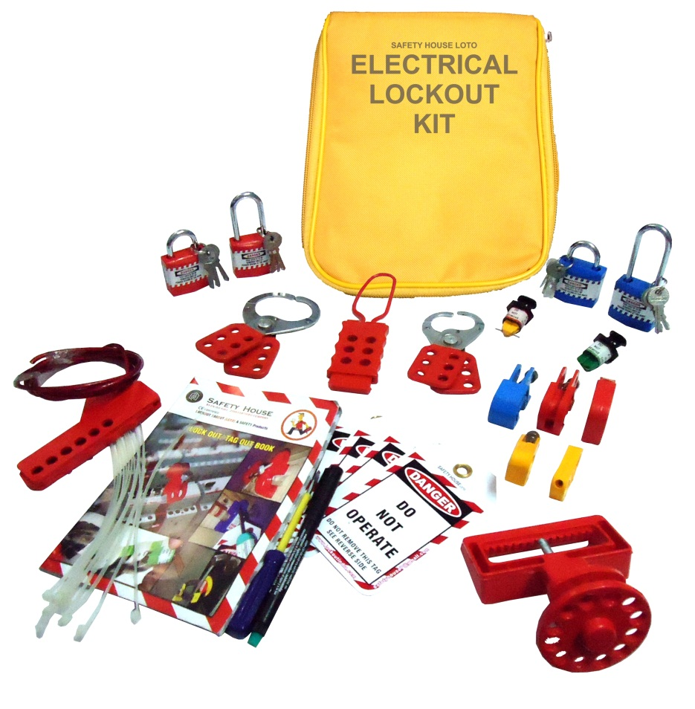
Safety House
BS EN ISO 9001 : 2008 CERTIFIED COMPANY
House of all Safety Products
CE Certified products
Item code - SH-Yellow-Bag-Kit-3 – Rs.1,627/- MRP-3,254/-
Lockout Bag - Yellow - 1 pc
Lockout Tag – 10 pcs
Lockout Guide Book – 1 pc
Dielectric Padlock long and regular shackle – 4 pcs.
Vinyl coated Hasp – Small – 1 pc
Vinyl coated Hasp – Premier – 1 pc
Dielectric Hasp with 6 holes – 1 pc
Scissor Cable Lockout– 1 pc
Pin Type MCB Lockout – 2 pcs
MCB Lockout different models – 5 pcs.
MCCB Lockout – 1 pc
Writing Pen – 1 pc
Screw Driver – 1 pc
Add: 12/16, 3rd floor, Ashok Nagar, New Delhi-110018 (INDIA), Ph. : +91 11 2598 1265
M : +919999 656979, 99710 87519, E-mail : safetyhouse7@gmail.com, safetyhouse7@yahoo.com

Slide 13
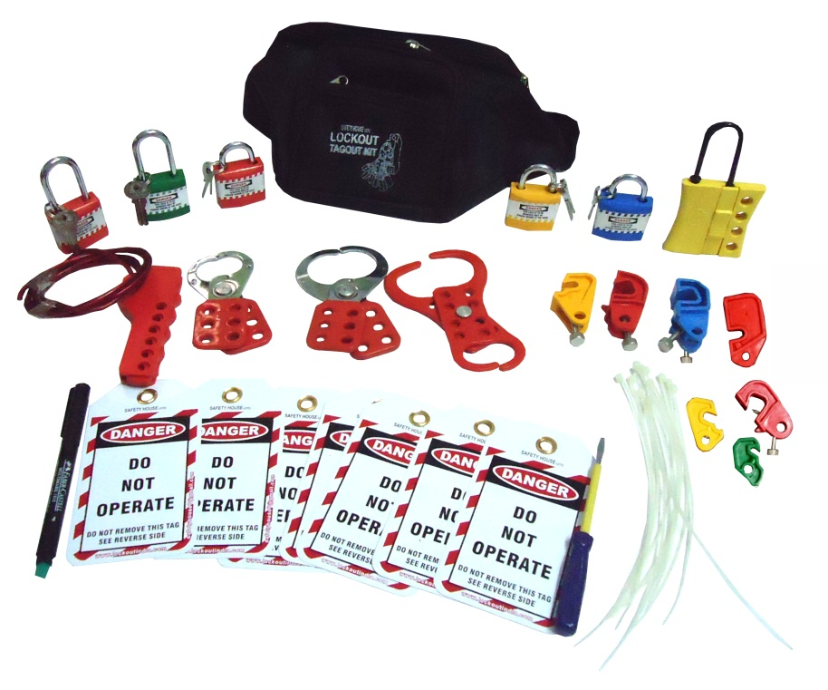
Safety House
BS EN ISO 9001 : 2008 CERTIFIED COMPANY
House of all Safety Products
CE Certified products
Item code - SH-Black-WP-Kit-1 – Rs.1,663/- MRP-Rs.3,326/-
Lockout Waist Pouch - Black- 1 pc
Lockout Tag – 10 pcs
Lockout Guide Book – 1 pc
Dielectric Padlock long and regular shackle – 5 pcs.
Vinyl coated Hasp – Small – 1 pc
Vinyl coated Hasp – Premier – 1 pc
Double Jaw Hasp – 1 pc
Scissor Cable Lockout– 1 pc
MCB Lockout different models – 7 pcs.
Slider Hasp – 1 pc
Writing Pen – 1 pc
Screw Driver – 1 pc
Add: 12/16, 3rd floor, Ashok Nagar, New Delhi-110018 (INDIA), Ph. : +91 11 2598 1265
M : +919999 656979, 99710 87519, E-mail : safetyhouse7@gmail.com, safetyhouse7@yahoo.com

Slide 14
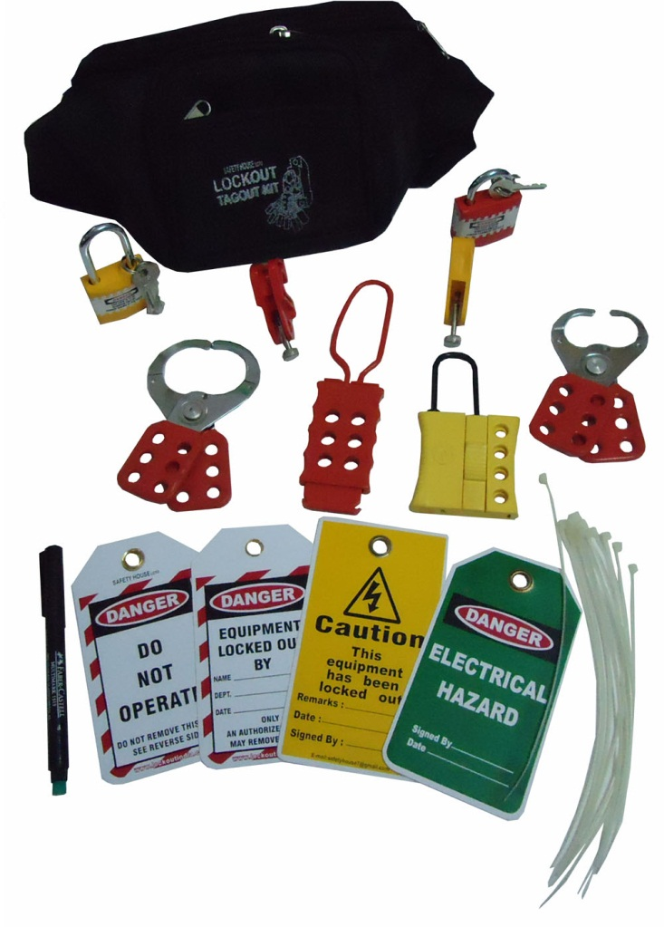
Safety House
BS EN ISO 9001 : 2008 CERTIFIED COMPANY
House of all Safety Products
CE Certified products
Item code - SH-Black-WP-Kit-2- Rs. 912/- MRP- 1,824/-
Lockout Waist Pouch - Black- 1 pc
Lockout Tag – 5 pcs
Dielectric Padlock long and regular shackle – 3 pcs.
Vinyl coated Hasp – Small – 1 pc
Vinyl coated Hasp – Premier – 1 pc
Dielectric Hasp with 6 holes – 1 pc
MCB Lockout different models – 2 pcs.
Slider Hasp – 1 pc
Writing Pen – 1 pc
Lockout Ties – 5 pcs
Add: 12/16, 3rd floor, Ashok Nagar, New Delhi-110018 (INDIA), Ph. : +91 11 2598 1265
M : +919999 656979, 99710 87519, E-mail : safetyhouse7@gmail.com, safetyhouse7@yahoo.com

Slide 15
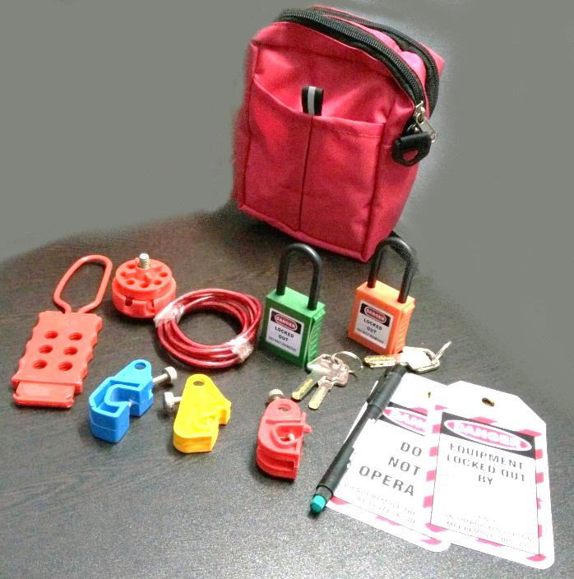
Safety House
BS EN ISO 9001 : 2008 CERTIFIED COMPANY
House of all Safety Products
CE Certified products
Item code - SH-Red Pouch Kit – Rs.1485/- MRP – Rs.3712/-
Lockout Waist Pouch - Red - 1 pc
Lockout Tag – 2 pcs
Dielectric OSHA Padlock – 2 pcs.
Dielectric Hasp with 6 holes – 1 pc
MCB Lockout different models – 3 pcs.
Round Cable Lockout – 1 pc
Writing marker pen - 1
Add: 12/16, 3rd floor, Ashok Nagar, New Delhi-110018 (INDIA), Ph. : +91 11 2598 1265
M : +919999 656979, 99710 87519, E-mail : safetyhouse7@gmail.com, safetyhouse7@yahoo.com

Slide 16
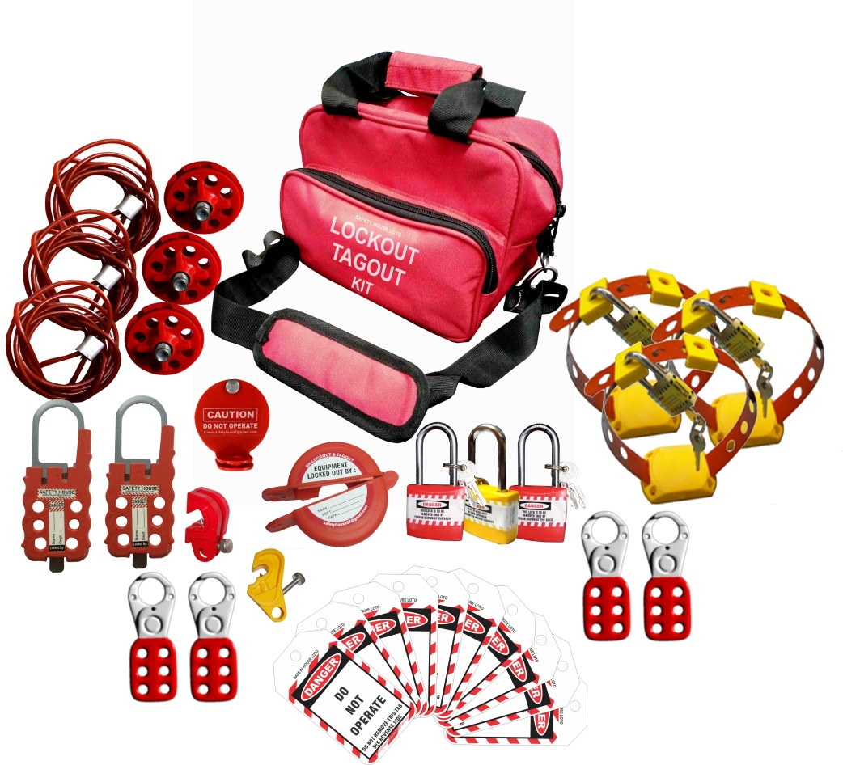
House of all Safety Products
CE Certified products
Item code - SH-ELEC-CABLE-KIT – Rs.2660/- MRP – 5320/-
Lockout Red Bag – 1 pc
Padlock long shackle yellow red color – 3 Pc
Lockout Small hasp – 4 pc
MUCB Yellow lockout – 1 pc
Handle Lockout – 3 pc
Lockout push button – 1 pc
Lockout Tag – 10 pc
Round cable lockout – 3 pc
Big Multipurpose Cable lockout – 2 pc
Rack cover lockout – 1 pc
Add: 12/16, 3rd floor, Ashok Nagar, New Delhi-110018 (INDIA), Ph. : +91 11 2598 1265
M : +919999 656979, 99710 87519, E-mail : safetyhouse7@gmail.com, safetyhouse7@yahoo.com

Slide 17
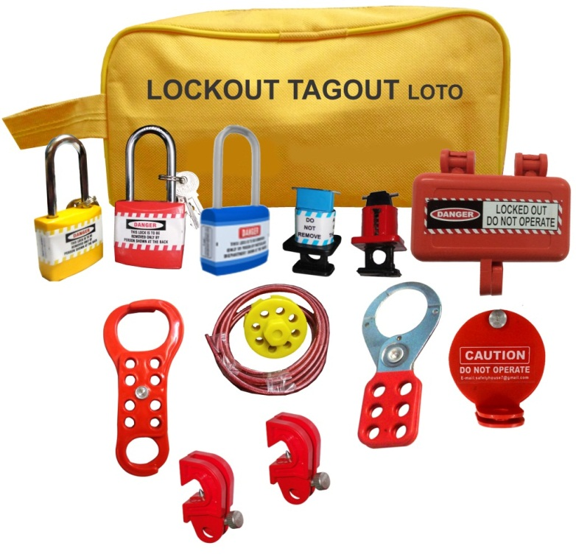
House of all Safety Products
CE Certified products
Item code – Yellow Electrical Kit Small – 1 – Rs.1248/- MRP – Rs. 2496/-
Lockout Yellow Pouch – 1 pc
Padlock long shackle diffrent color – 3 Pc
Lockout hasp big - 1 Pc
Plug lockout small – 1 pc
Lockout Rackout Cover – 1 pc
Round cable lockout – 1 pc
Lockout Pin different model – 2 pc
Universal Circuit Breaker Lockout – 2 pc
Di-Electric 6 hole hasp – 1 pc
Add: 12/16, 3rd floor, Ashok Nagar, New Delhi-110018 (INDIA), Ph. : +91 11 2598 1265
M : +919999 656979, 99710 87519, E-mail : safetyhouse7@gmail.com, safetyhouse7@yahoo.com

Slide 18
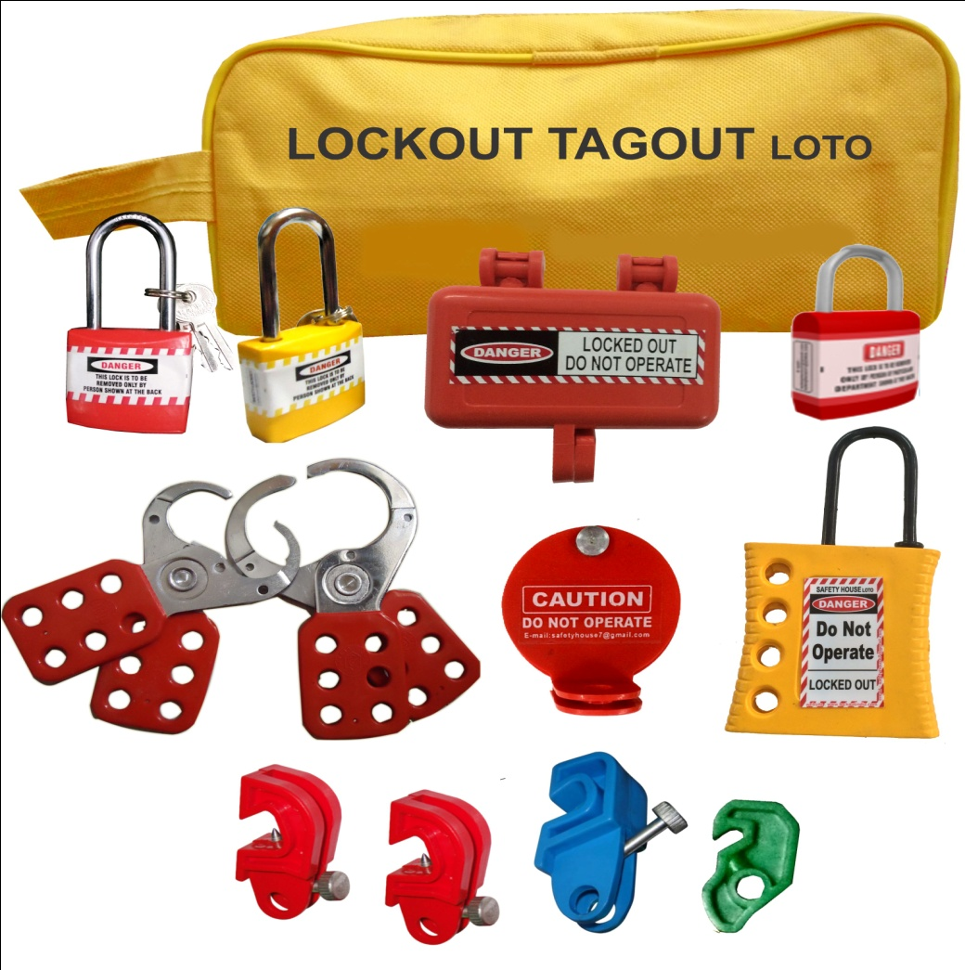
House of all Safety Products
CE Certified products
Item code – Yellow Electrical Kit Small – 2 – Rs. 1111/- mrp2230/-
Lockout Yellow Pouch – 1 pc
Padlock long shackle diffrent color – 2 Pc
Padlock Regular shackle re color – 1 pc
Lockout hasp small- 1 pc
Lockout hasp big - 1 Pc
Plug lockout small – 1 pc
Lockout Rackout Cover – 1 pc
Dielectric Yellow Hasp – 1 pc
UCB lockout different model – 4 pc
Add: 12/16, 3rd floor, Ashok Nagar, New Delhi-110018 (INDIA), Ph. : +91 11 2598 1265
M : +919999 656979, 99710 87519, E-mail : safetyhouse7@gmail.com, safetyhouse7@yahoo.com

Slide 19
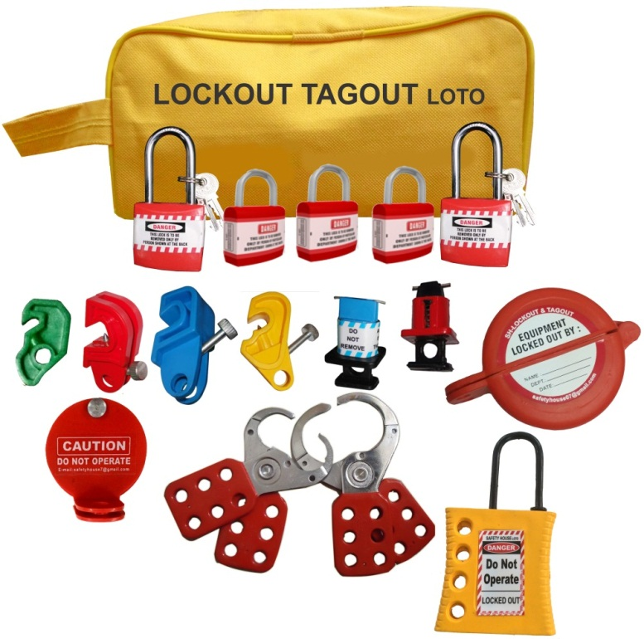
House of all Safety Products
CE Certified products
Item code – Yellow Electrical Kit Small – 3 – Rs.1356/ - MRP 3000/-
Lockout Yellow Pouch – 1 pc
Padlock long shackle red color – 2 Pc
Padlock regular shackle red color – 3pc
Lockout hasp small- 1 pc
Lockout hasp big - 1 Pc
Lockout Push Button – 1 pc
Lockout Rackout Cover – 1 pc
Lockout Pin different model – 2 pc
Universal Circuit Breaker Lockout – 4 pc
Dielectric Yellow Hasp – 1 pc
Add: 12/16, 3rd floor, Ashok Nagar, New Delhi-110018 (INDIA), Ph. : +91 11 2598 1265
M : +919999 656979, 99710 87519, E-mail : safetyhouse7@gmail.com, safetyhouse7@yahoo.com

Slide 20
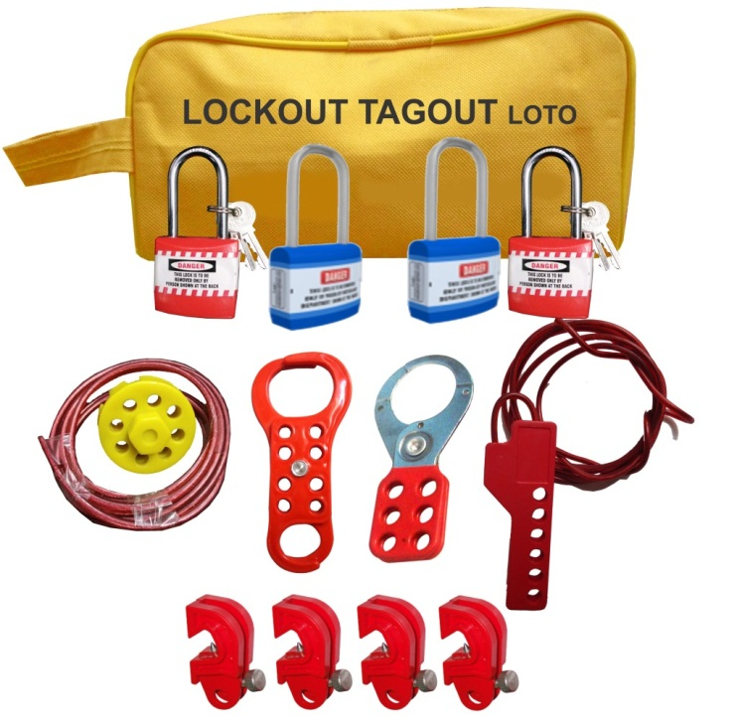
House of all Safety Products
CE Certified products
Item code – Yellow Electrical Kit Small – 4- 1204/- MRP – 2500/-
Lockout Yellow Pouch – 1 pc
Padlock long shackle different color – 4 Pc
Lockout hasp big - 1 Pc
Universal Circuit Breaker Lockout – 4 pc
Scissor cable Lockout – 1 pc
Lockout Dual Scissor 6 Hasp – 1 Pc
Round cable lockout – 1 pc
Add: 12/16, 3rd floor, Ashok Nagar, New Delhi-110018 (INDIA), Ph. : +91 11 2598 1265
M : +919999 656979, 99710 87519, E-mail : safetyhouse7@gmail.com, safetyhouse7@yahoo.com

Slide 21
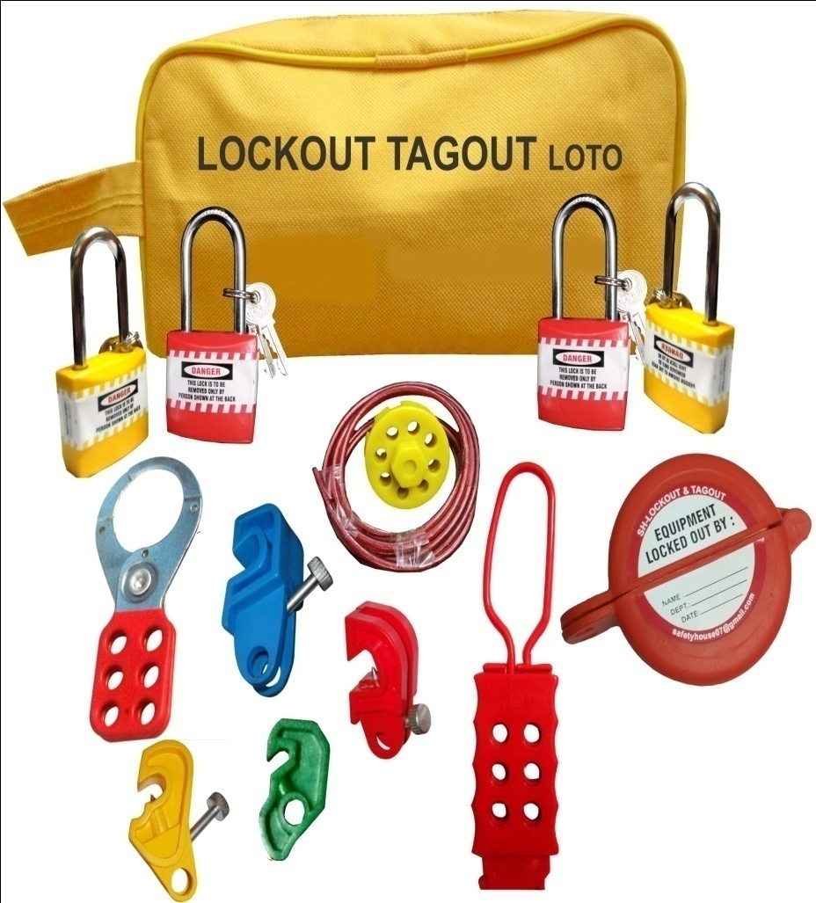
House of all Safety Products
CE Certified products
Item code – Yellow Electrical Kit Small - 5
Lockout Yellow Pouch – 1 pc
Padlock long shackle diffrent color – 4 Pc
UCB different model – 4 pc
Dielectric 6 hole hasp – 1 pc
Round cable lockout – 1 pc
Lockout push button – 1 pc
Lockout Hasp Big – 1 pc
Add: 12/16, 3rd floor, Ashok Nagar, New Delhi-110018 (INDIA), Ph. : +91 11 2598 1265
M : +919999 656979, 99710 87519, E-mail : safetyhouse7@gmail.com, safetyhouse7@yahoo.com

Slide 22
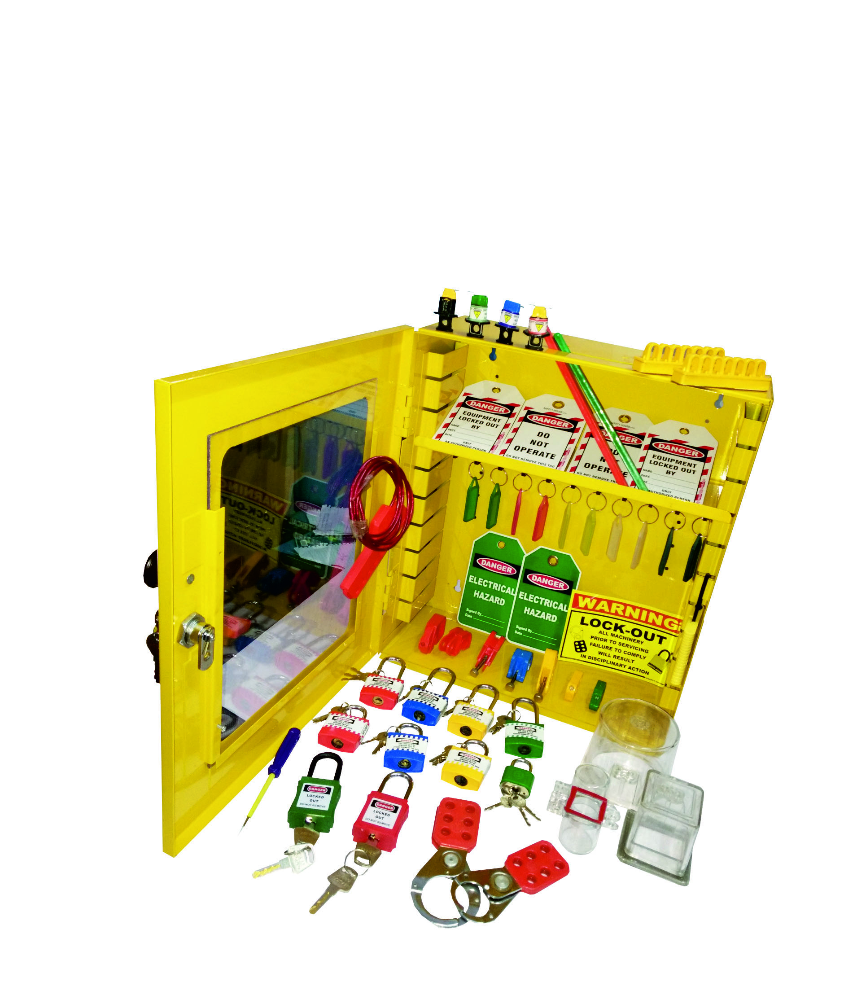
House of all Safety Products
CE Certified products
Item code – SH-STATION-ELEC-KIT-2 – Rs.4900/- MRP – 9900/-
Lockout station 6inch - 1 Pc
MCB Lockout different model - 7 pc
Lockout padlock Long shackle – 4 pc
Lockout padlock Regular shackle –4 pc
Dielectric padlock – 2 Pc
Lockout hasp small – 1 pc
Lockout hasp big – 1 pc
Lockout tag – 10 – pc
Lockout green tag – 2 Pc
Scissor cable lockout – 1 Pc
Screw driver – 1 Pc
Lockout Sign – 1 Pc
Lockout Pin different color – 3 Pc
Breaker lockout kit – 1Pc
Electrical Panel Lockout transprent different modal – 3 Pc
Lockout Keyring different color – 10 Pc
Add: 12/16, 3rd floor, Ashok Nagar, New Delhi-110018 (INDIA), Ph. : +91 11 2598 1265
M : +919999 656979, 99710 87519, E-mail : safetyhouse7@gmail.com, safetyhouse7@yahoo.com

Slide 23
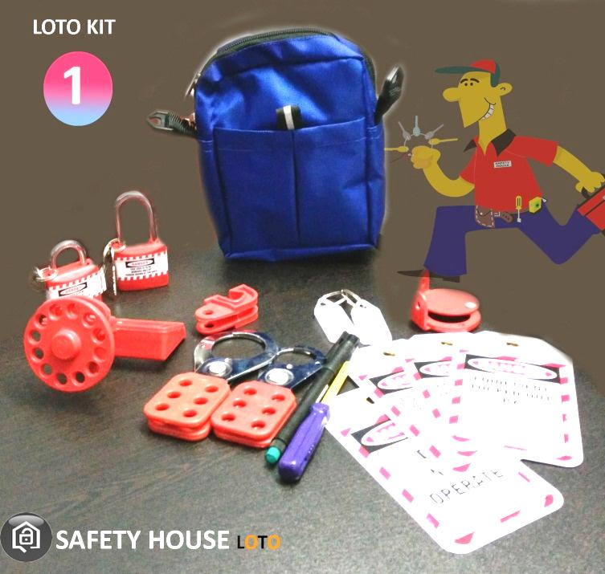
Safety House
BS EN ISO 9001 : 2008 CERTIFIED COMPANY
House of all Safety Products
CE Certified products
Item code - SH-Blue Pouch kit – Rs.975/- MRP – Rs.2200/-
Lockout Waist Pouch - Blue - 1 pc
Lockout Tag – 5 pcs
Rack In Out device – 1 pc
MCCB Lockout – 1 pc
Lockout Padlock – Long and regular – 2 pcs.
Lockout Hasp – Small – 1 pc
Lockout Hasp – Premier – 1 pc
MCB Lockout– 1 pc
Writing marker pen – 1
Screw Driver – 1 pc
Keyrings – 2 pcs
Add: 12/16, 3rd floor, Ashok Nagar, New Delhi-110018 (INDIA), Ph. : +91 11 2598 1265
M : +919999 656979, 99710 87519, E-mail : safetyhouse7@gmail.com, safetyhouse7@yahoo.com

Slide 24
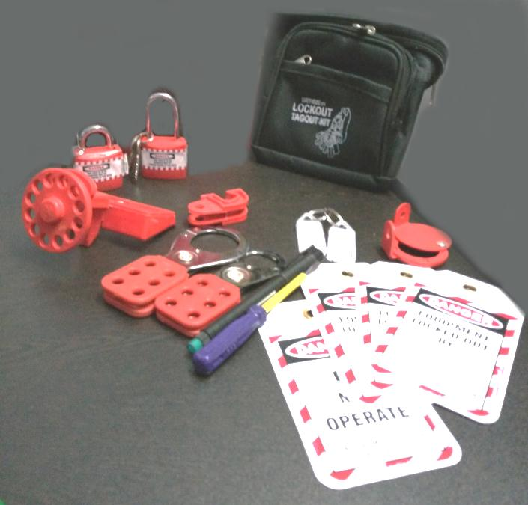
Safety House
BS EN ISO 9001 : 2008 CERTIFIED COMPANY
House of all Safety Products
CE Certified products
Item code - SH-Black Waist pouch kit – Rs.960/- MRP 2000/-
Lockout Waist Pouch - Black - 1 pc
Lockout Tag – 5 pcs
Rack In Out device – 1 pc
MCCB Lockout – 1 pc
Lockout Padlock – Long and regular – 2 pcs.
Lockout Hasp – Small – 1 pc
Lockout Hasp – Premier – 1 pc
MCB Lockout– 1 pc
Writing marker pen – 1
Screw Driver – 1 pc
Keyrings – 2 pcs
Add: 12/16, 3rd floor, Ashok Nagar, New Delhi-110018 (INDIA), Ph. : +91 11 2598 1265
M : +919999 656979, 99710 87519, E-mail : safetyhouse7@gmail.com, safetyhouse7@yahoo.com

Slide 25
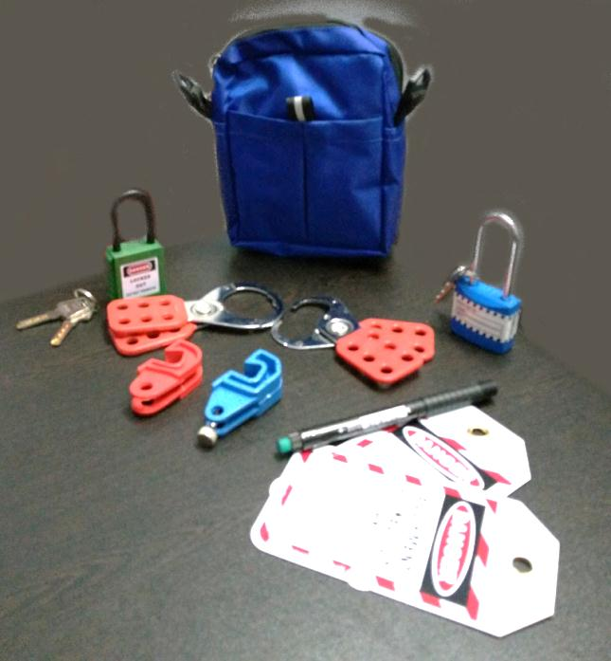
Safety House
BS EN ISO 9001 : 2008 CERTIFIED COMPANY
House of all Safety Products
CE Certified products
Item code - SH-Blue Waist pouch kit – Rs.1035/- MRP – Rs.2328/-
Lockout Waist Pouch - Blue - 1 pc
Lockout Tag – 2 pcs
Lockout Padlock – Long shackle – 1 pc
OSHA Padlock – 1 pc
Lockout Hasp – Small – 1 pc
Lockout Hasp – Premier – 1 pc
MCB Lockout– 2 pcs
Writing marker pen – 1 pc
Add: 12/16, 3rd floor, Ashok Nagar, New Delhi-110018 (INDIA), Ph. : +91 11 2598 1265
M : +919999 656979, 99710 87519, E-mail : safetyhouse7@gmail.com, safetyhouse7@yahoo.com

Slide 26
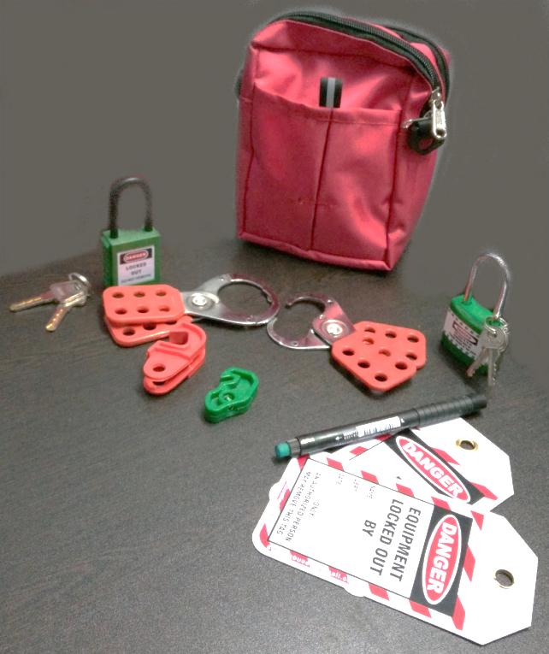
Safety House
BS EN ISO 9001 : 2008 CERTIFIED COMPANY
House of all Safety Products
CE Certified products
Item code - SH-Red Waist pouch kit– Rs.1035/- MRP – Rs.2328/-
Lockout Waist Pouch - Red - 1 pc
Lockout Tag – 2 pcs
Lockout Padlock – Long shackle – 1 pc
OSHA Padlock – 1 pc
Lockout Hasp – Small – 1 pc
Lockout Hasp – Premier – 1 pc
MCB Lockout– 2 pcs
Writing marker pen – 1 pc
Add: 12/16, 3rd floor, Ashok Nagar, New Delhi-110018 (INDIA), Ph. : +91 11 2598 1265
M : +919999 656979, 99710 87519, E-mail : safetyhouse7@gmail.com, safetyhouse7@yahoo.com

Slide 27
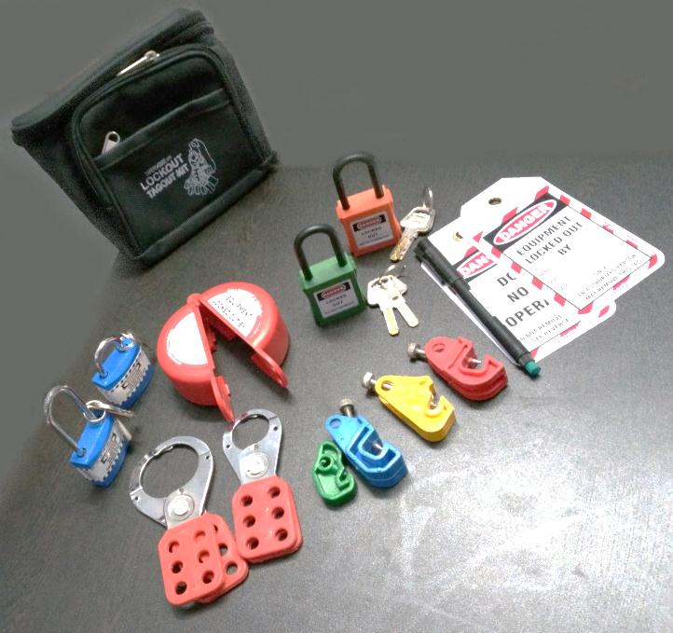
Safety House
BS EN ISO 9001 : 2008 CERTIFIED COMPANY
House of all Safety Products
CE Certified products
Item code - SH-Black Waist pouch kit- Rs.1685/-MRP-Rs.3792/-
Lockout Waist Pouch - Black - 1 pc
Lockout Tag – 2 pcs
Lockout Padlock – Long and regular shackle – 2 pcs
OSHA Padlock – 2 pcs
Lockout Hasp – Small – 1 pc
Lockout Hasp – Premier – 1 pc
MCB Lockout– 4 pcs
Push button lockout – 1 pc
Writing marker pen – 1 pc
Add: 12/16, 3rd floor, Ashok Nagar, New Delhi-110018 (INDIA), Ph. : +91 11 2598 1265
M : +919999 656979, 99710 87519, E-mail : safetyhouse7@gmail.com, safetyhouse7@yahoo.com

Slide 28

Safety House
BS EN ISO 9001 : 2008 CERTIFIED COMPANY
House of all Safety Products
CE Certified products
Item code - SH-Red Waist pouch kit – Rs.1255/- MRP-2824/-
Lockout Waist Pouch - Red - 1 pc
Lockout Tag – 2 pcs
Dielectric Hasp – 1 pc
Round cable lockout – 1 pc
OSHA Padlock – 2 pcs
MCB Lockout– 3 pcs
Push button lockout – 1 pc
Writing marker pen – 1 pc
Add: 12/16, 3rd floor, Ashok Nagar, New Delhi-110018 (INDIA), Ph. : +91 11 2598 1265
M : +919999 656979, 99710 87519, E-mail : safetyhouse7@gmail.com, safetyhouse7@yahoo.com

Slide 29
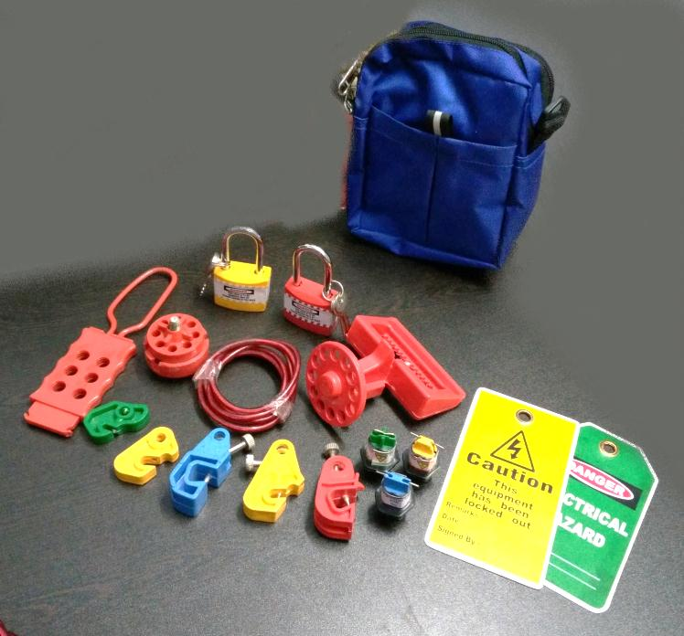
Safety House
BS EN ISO 9001 : 2008 CERTIFIED COMPANY
House of all Safety Products
CE Certified products
Item code - SH-Blue Waist pouch kit- Rs.1270/-MRP-2857/-
Lockout Waist Pouch - Blue - 1 pc
Lockout Tag – 2 pcs
Dielectric Hasp – 1 pc
Round cable lockout – 1 pc
MCCB Lockout – 1 pc
Lockout Padlock – Long shackle – 2 pcs
MCB Lockout– 5 pcs
Pin Type MCB Lockout – 3 pcs
Add: 12/16, 3rd floor, Ashok Nagar, New Delhi-110018 (INDIA), Ph. : +91 11 2598 1265
M : +919999 656979, 99710 87519, E-mail : safetyhouse7@gmail.com, safetyhouse7@yahoo.com

Slide 30
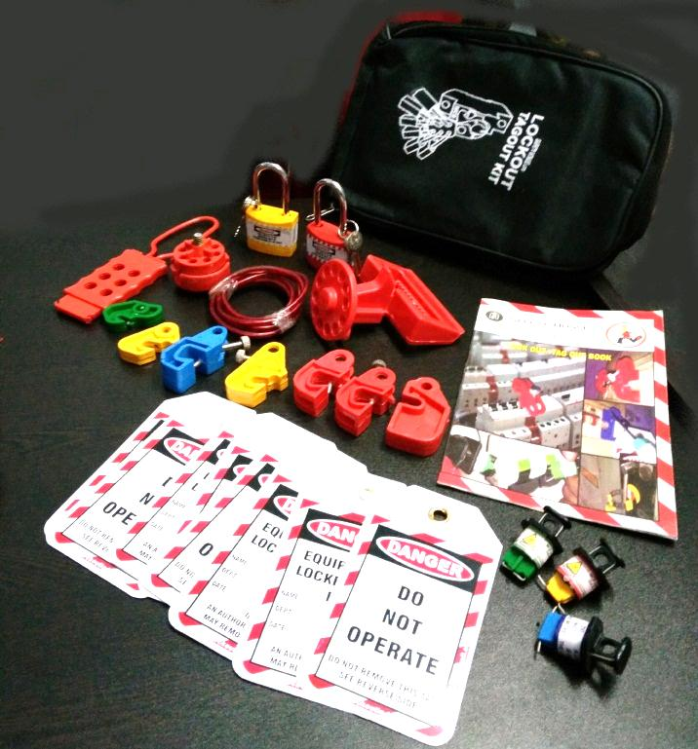
Safety House
BS EN ISO 9001 : 2008 CERTIFIED COMPANY
House of all Safety Products
CE Certified products
Item code – SH-Black pouch kit-Rs.1470/-MRP-3307/-
Lockout Pouch - Black - 1 pc
Lockout Tag – 5 pcs
Dielectric Hasp – 1 pc
Round cable lockout – 1 pc
MCCB Lockout – 1 pc
Lockout Padlock – Long shackle – 2 pcs
MCB Lockout– 7 pcs
Pin Type MCB Lockout – 3 pcs
Lockout Book – 1 pc
Add: 12/16, 3rd floor, Ashok Nagar, New Delhi-110018 (INDIA), Ph. : +91 11 2598 1265
M : +919999 656979, 99710 87519, E-mail : safetyhouse7@gmail.com, safetyhouse7@yahoo.com

Slide 31
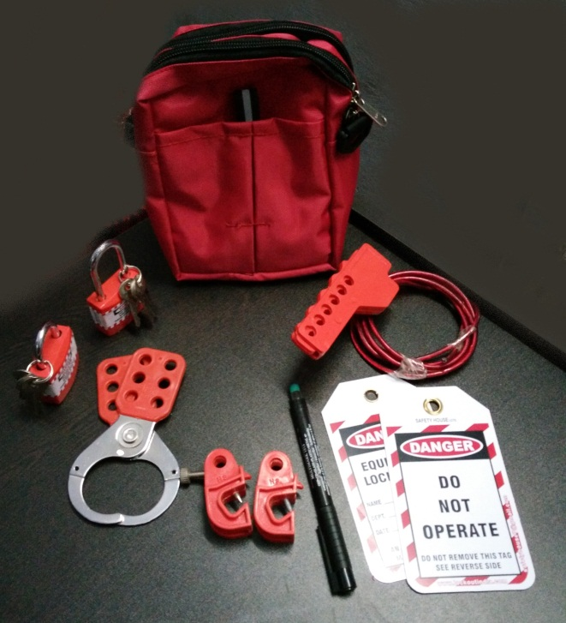
Safety House
BS EN ISO 9001 : 2008 CERTIFIED COMPANY
House of all Safety Products
CE Certified products
Item code – SH-Red pouch kit-Rs.795/- MRP-1788/-
Lockout Pouch - Red - 1 pc
Lockout Tag – 2 pcs
Vinyl coated Hasp – premier – 1 pc
Scissor type cable lockout – 1 pc
Lockout Padlock – Long shackle – 2 pcs
MCB Lockout– 2 pcs
Writing pen – 1 pc
Add: 12/16, 3rd floor, Ashok Nagar, New Delhi-110018 (INDIA), Ph. : +91 11 2598 1265
M : +919999 656979, 99710 87519, E-mail : safetyhouse7@gmail.com, safetyhouse7@yahoo.com

Slide 32
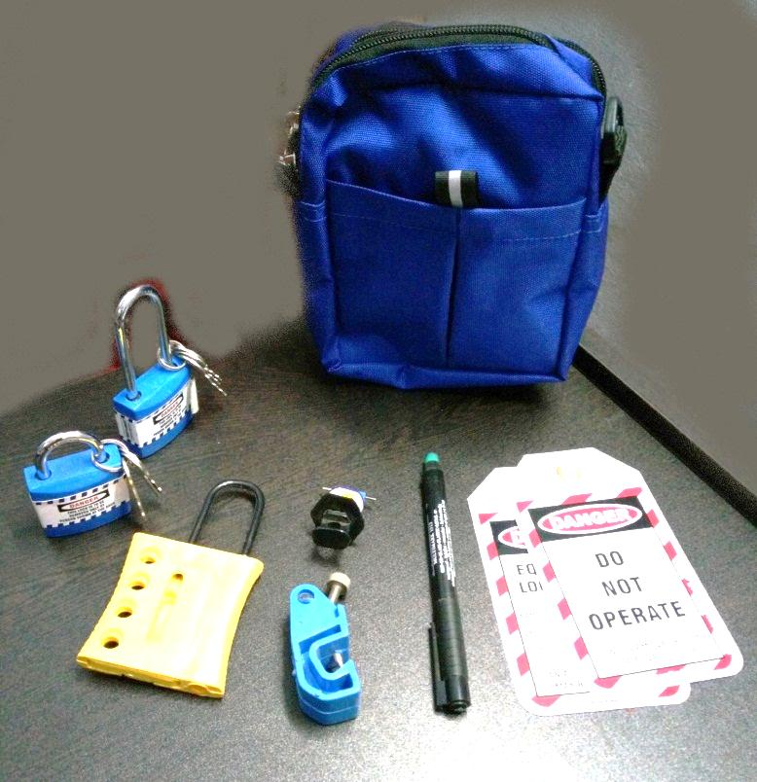
Safety House
BS EN ISO 9001 : 2008 CERTIFIED COMPANY
House of all Safety Products
CE Certified products
Item code – SH-Blue pouch kit-Rs.655/- MRP-1474/-
Lockout Pouch – Blue - 1 pc
Lockout Tag – 2 pcs
Dielectric Hasp – Yellow – 1 pc
Pin Type MCB Lockout – 1 pc
Lockout Padlock – Long and regular shackle – 2 pcs
MCB Lockout– 1 pc
Writing pen – 1 pc
Add: 12/16, 3rd floor, Ashok Nagar, New Delhi-110018 (INDIA), Ph. : +91 11 2598 1265
M : +919999 656979, 99710 87519, E-mail : safetyhouse7@gmail.com, safetyhouse7@yahoo.com

Slide 33
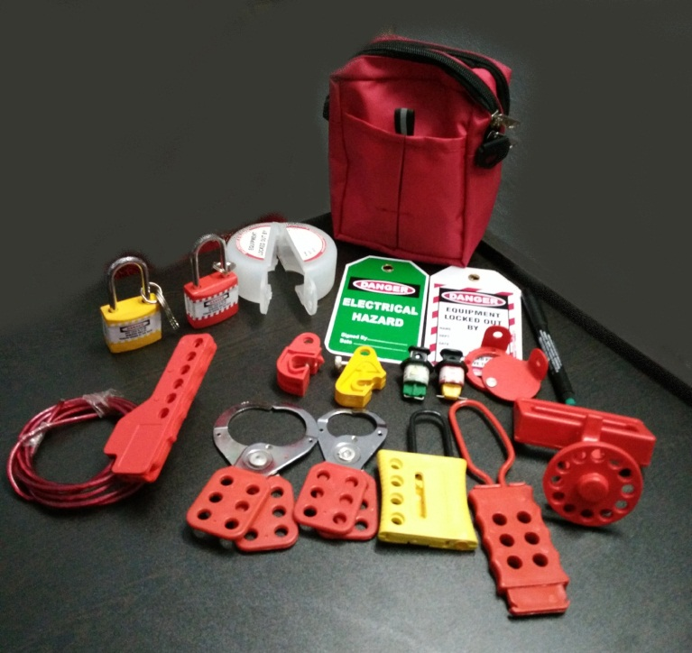
Safety House
BS EN ISO 9001 : 2008 CERTIFIED COMPANY
House of all Safety Products
CE Certified products
Item code – SH-Red pouch kit-Rs.1485/- MRP-3342/-
Lockout Pouch – Red - 1 pc
Lockout Tag – 2 pcs
Dielectric Hasp – Yellow – 1 pc
Dielectric Hasp with 6 holes – 1 pc
Vinyl coated Hasp – Small – 1 pc
Vinyl coated Hasp – Premier – 1 pc
Push button Lockout – 1 pc
Pin Type MCB Lockout – 2 pcs
Lockout Padlock – Long and regular shackle – 2 pcs
Scissor Type cable Lockout – 1 pc
MCB Lockout– 2 pcs
MCCB Lockout – 1 pc
Rack In Out Device – 1 pc
Writing pen – 1 pc
Add: 12/16, 3rd floor, Ashok Nagar, New Delhi-110018 (INDIA), Ph. : +91 11 2598 1265
M : +919999 656979, 99710 87519, E-mail : safetyhouse7@gmail.com, safetyhouse7@yahoo.com

Slide 34
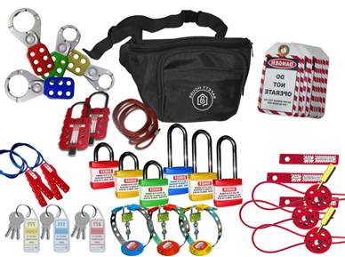
Safety House
BS EN ISO 9001 : 2008 CERTIFIED COMPANY
House of all Safety Products
CE Certified products
Item code - SH-EWP-KIT – Rs.2,665/- MRP – 5330/-
Lockout Waist Pouch - 1 pc
Lockout Hasp – Small – 2 pcs
Lockout Hasp – Premier – 2 pcs
Lockout Tag – 10 pcs
Handle Lockout – 3 pcs
Padlock – Longs shackle – 3 pcs
Padlock – Regular shackle – 3 pcs
Keyrings – 3 pcs
Round Cable Lockout – 2 pcs
Big Multipurpose Cable Lockout – 2 pcs
Scissor Type Cable Lockout – 2 pcs
Handle Lockout – 3 pcs
Add: 12/16, 3rd floor, Ashok Nagar, New Delhi-110018 (INDIA), Ph. : +91 11 2598 1265
M : +919999 656979, 99710 87519, E-mail : safetyhouse7@gmail.com, safetyhouse7@yahoo.com

Slide 35
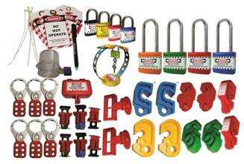
Safety House
BS EN ISO 9001 : 2008 CERTIFIED COMPANY
House of all Safety Products
CE Certified products
Item code - SH-MCB-L-KIT –Rs.2915/- MRP-5900/-
Lockout Hasp – Small – 3 pcs
Lockout Hasp – Premier – 3 pcs
Lockout Tag – 10 pcs
Writing Marker pen – 1 pc
Lockout Ties – 10 pcs
Lockout Padlock – Long shackle – 4 pcs
Lockout padlock – Regular shackle – 4 pcs
MCB Lockout – different models – 10 pcs
Pin Type MCB Lockout – 3 pcs
MCCB / LCB Lockout – 2 pcs
Plug Lockout – Small – 1 pc
Electrical Panel Lockout - Small – Round – 1 pc
Handle Lockout – 1 pc
Writing Marker Pen – 1 pc
Add: 12/16, 3rd floor, Ashok Nagar, New Delhi-110018 (INDIA), Ph. : +91 11 2598 1265
M : +919999 656979, 99710 87519, E-mail : safetyhouse7@gmail.com, safetyhouse7@yahoo.com

Slide 36
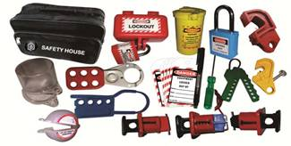
Safety House
BS EN ISO 9001 : 2008 CERTIFIED COMPANY
House of all Safety Products
CE Certified products
Item code - SH-PLUG-L-KIT – Rs.1900/- MRP-Rs.3900/-
Lockout Bag- 1 pc
Lockout Hasp – Small – 1 pc
Dielectric Hasp – 1 pc
Lockout Tag – 2 pcs
Plug Lockout – Small – 1 pc
Cylinder Lockout – 1 pc
MCB Lockout – Different models – 2 pcs
Pin Type MCB Lockout – 3 pcs
Dielectric padlock – 1 pc
Push button Lockout – 1 pc
Electrical Panel Lockout – 1 pc
Scissor Type Cable Lockout – 1 pc
Writing Marker pen – 1 pc
Screw Driver – 1 pc
Add: 12/16, 3rd floor, Ashok Nagar, New Delhi-110018 (INDIA), Ph. : +91 11 2598 1265
M : +919999 656979, 99710 87519, E-mail : safetyhouse7@gmail.com, safetyhouse7@yahoo.com

Slide 37
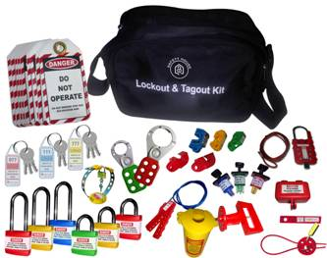
Safety House
BS EN ISO 9001 : 2008 CERTIFIED COMPANY
House of all Safety Products
CE Certified products
Item code - SH-ELEC-LOTO-KIT-Rs.3040/-MRP-6840/-
Lockout Bag- 1 pc
Lockout Hasp – Small – 1 pc
Lockout Hasp – Premier – 1 pc
Lockout Tag – 10 pcs
Handle Lockout – 1 pc
Plug Lockout – Small – 1 pc
Cylinder Lockout – 1 pc
MCB Lockout – Different models – 5 pcs
Pin Type MCB Lockout – 3 pcs
Padlock – Longs shackle – 3 pcs
Padlock – Regular shackle – 3 pcs
Keyrings – 3 pcs
Round Cable Lockout – 1 pc
Big Multipurpose Cable Lockout – 1 pc
Scissor Type Cable Lockout – 1 pc
Add: 12/16, 3rd floor, Ashok Nagar, New Delhi-110018 (INDIA), Ph. : +91 11 2598 1265
M : +919999 656979, 99710 87519, E-mail : safetyhouse7@gmail.com, safetyhouse7@yahoo.com

Slide 38
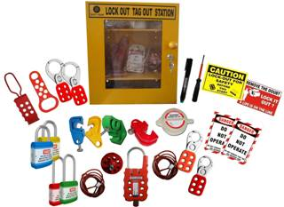
Safety House
BS EN ISO 9001 : 2008 CERTIFIED COMPANY
House of all Safety Products
CE Certified products
Item code - SH-LT-STATION-KIT-Rs.3550/-MRP-7987/-
Lockout Station- 1 pc
Lockout Hasp – Small – 2 pcs
Lockout Hasp – Premier – 2 pcs
Dielectric Hasp – 1 pc
Double Jaw Hasp – 1 pc
MCB Lockout – different Models – 4 pcs
Writing Marker pen – 1 pc
Lockout Tag – 5 pcs
Padlock – Longs shackle – 2 pcs
Padlock – Regular shackle – 2 pcs
Lockout Labels – 2 pcs
Round Cable Lockout – 1 pc
Big Multipurpose Cable Lockout – 1 pc
Push Button Lockout – 1 pc
Screw Driver – 1 pc
Add: 12/16, 3rd floor, Ashok Nagar, New Delhi-110018 (INDIA), Ph. : +91 11 2598 1265
M : +919999 656979, 99710 87519, E-mail : safetyhouse7@gmail.com, safetyhouse7@yahoo.com

Slide 39
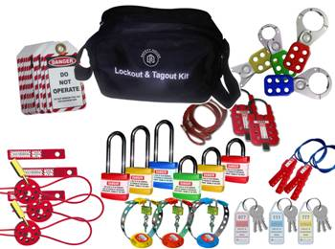
Safety House
BS EN ISO 9001 : 2008 CERTIFIED COMPANY
House of all Safety Products
CE Certified products
Item code - SH-ELEC-LOTO-KIT – Rs.2915/-MRP-Rs.5900/-
Lockout Bag- 1 pc
Lockout Hasp – Small – 2 pcs
Lockout Hasp – Premier – 2 pcs
Lockout Tag – 10 pcs
Padlock – Longs shackle – 3 pcs
Padlock – Regular shackle – 3 pcs
Keyrings – 6 pcs
Round Cable Lockout – 3 pcs
Big Multipurpose Cable Lockout – 2 pcs
Scissor Type Cable Lockout – 2 pcs
Handle Lockout – 3 pcs.
Add: 12/16, 3rd floor, Ashok Nagar, New Delhi-110018 (INDIA), Ph. : +91 11 2598 1265
M : +919999 656979, 99710 87519, E-mail : safetyhouse7@gmail.com, safetyhouse7@yahoo.com

Slide 40
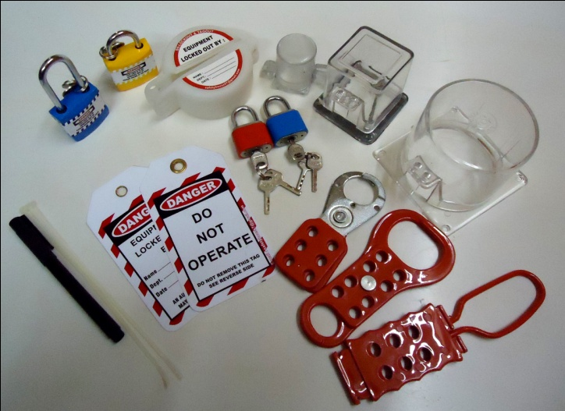
Safety House
BS EN ISO 9001 : 2008 CERTIFIED COMPANY
House of all Safety Products
CE Certified products
Item code - SH-PB-LOTO-KIT – Rs. 1010/- MRP-Rs.2050/-
Lockout Hasp – Small – 1 pc
Dielectric Hasp – 1 pc
Double Jaw Hasp – 1 pc
Lockout Tag – 2 pcs
Push Button Lockout – 1 pc
Padlock – Long shackle – 1 pc
Padlock – regular shackle – 1 pc
Small Locks – 2 pcs
Electrical Panel Lockout – small – Round – 1 pc
Electrical Panel Lockout – Small – Square – 1 pc
Electrical Panel lockout – Large – Square – 1 pc
Writing Marker pen – 1 pc
Add: 12/16, 3rd floor, Ashok Nagar, New Delhi-110018 (INDIA), Ph. : +91 11 2598 1265
M : +919999 656979, 99710 87519, E-mail : safetyhouse7@gmail.com, safetyhouse7@yahoo.com

Slide 41
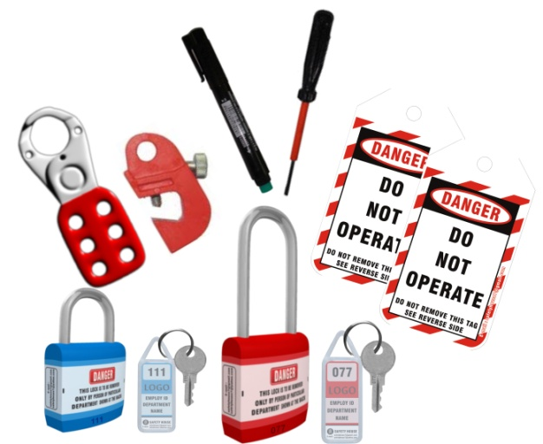
Safety House
BS EN ISO 9001 : 2008 CERTIFIED COMPANY
House of all Safety Products
CE Certified products
Item code - SH-ESSN-LOTO-KIT – 460/- Rs.990/-
Transparent Pouch – 1 pc
MCB Lockout – 1 pc
Lockout Hasp – Small – 1 pc
Lockout Tag – 2 pcs
Padlock – Long shackle – 1 pc
Padlock – regular shackle – 1 pc
Keyrings – 2 pcs
Screw Driver – 1 pc
Writing Marker pen – 1 pc
Add: 12/16, 3rd floor, Ashok Nagar, New Delhi-110018 (INDIA), Ph. : +91 11 2598 1265
M : +919999 656979, 99710 87519, E-mail : safetyhouse7@gmail.com, safetyhouse7@yahoo.com

Slide 42
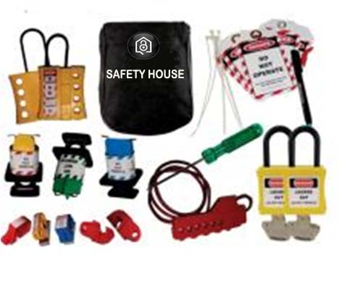
Safety House
BS EN ISO 9001 : 2008 CERTIFIED COMPANY
House of all Safety Products
CE Certified products
Item code - SH-MCB-SMALL-KIT – Rs.1290/- MRP – Rs.2600/-
Lockout Pouch – 1 pc
MCB Lockout – different Models – 5 pcs
PIN Type MCB Lockout – 3 pcs
Scissor type Cable Lockout – 1 pc
Lockout Tag – 5 pcs
Lockout Ties – 5 pcs
Dielectric Yellow Hasp – 2 pcs
Dielectric Padlock – 2 pcs
Screw Driver – 1 pc
Writing Marker pen – 1 pc
Add: 12/16, 3rd floor, Ashok Nagar, New Delhi-110018 (INDIA), Ph. : +91 11 2598 1265
M : +919999 656979, 99710 87519, E-mail : safetyhouse7@gmail.com, safetyhouse7@yahoo.com

Slide 43
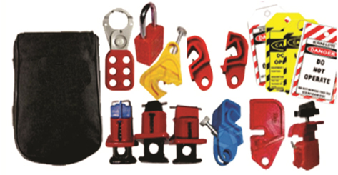
Safety House
BS EN ISO 9001 : 2008 CERTIFIED COMPANY
House of all Safety Products
CE Certified products
Item code - SH-MCB-POUCH-KIT – Rs.920/- MRP – Rs.1850/-
Lockout Pouch – 1 pc
MCB Lockout – different Models – 5 pcs
PIN Type MCB Lockout – 3 pcs
Tie Bar Lockout – 1 pc
Lockout Tag – 5 pcs
Lockout Ties – 5 pcs
Vinyl coated Hasp – 1 pc
Dielectric Padlock – 1 pc
Add: 12/16, 3rd floor, Ashok Nagar, New Delhi-110018 (INDIA), Ph. : +91 11 2598 1265
M : +919999 656979, 99710 87519, E-mail : safetyhouse7@gmail.com, safetyhouse7@yahoo.com

Slide 44
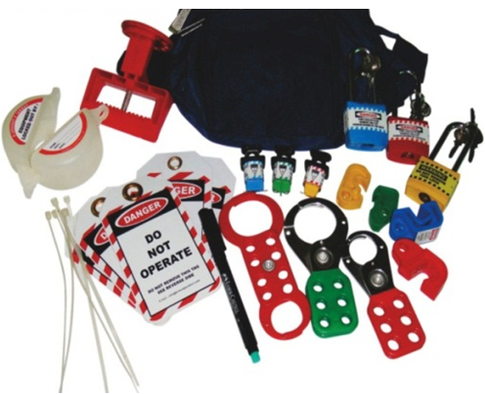
Safety House
BS EN ISO 9001 : 2008 CERTIFIED COMPANY
House of all Safety Products
CE Certified products
Item code - SH-MCB-WPOUCH-KIT–Rs.1390/- MRP– Rs.2800/-
Lockout Waist Pouch – 1 pc
Double jaw Hasp – 1 pc
Push Button Lockout – Round – 1 pc
MCB Lockout – different Models – 4 pcs
PIN Type MCB Lockout – 3 pcs
MCCB Lockout – 1 pc
Lockout Tag – 5 pcs
Lockout Ties – 5 pcs
Vinyl coated Hasp – 2 pcs
Padlock – Long shackle – 3 pcs
Writing pen – 1 pc
Add: 12/16, 3rd floor, Ashok Nagar, New Delhi-110018 (INDIA), Ph. : +91 11 2598 1265
M : +919999 656979, 99710 87519, E-mail : safetyhouse7@gmail.com, safetyhouse7@yahoo.com

Slide 45
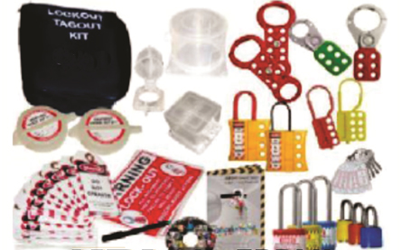
Safety House
BS EN ISO 9001 : 2008 CERTIFIED COMPANY
House of all Safety Products
CE Certified products
Item code - SH-PB-MED-LOTO-KIT – Rs.2000/- MRP 4100/-
Lockout Pouch – 1 pc
Dielectric Hasp – Yellow – 2 pcs
Double jaw Hasp – 2 pcs
Dielectric Hasp 6 holes – 2 pcs
Push Button Lockout – Round – 2 pcs
Electrical Panel Lockout – Small Round – 1 pc
Electrical Panel Lockout – Small Square – 1 pc
Electrical Panel Lockout – Large – Round - 1 pc
Lockout Tag – 10 pcs
Lockout Ties – 10 pcs
Vinyl coated Hasp – 2 pcs
Padlock – Long shackle – 2 pcs
Small Locks – 3 pcs
Lockout Labels – 2 pcs
Lockout Book – 1 pc
LOTO CD presentation – 1 pc
Keyring – 1 pcs
Writing pen – 1 pc
Add: 12/16, 3rd floor, Ashok Nagar, New Delhi-110018 (INDIA), Ph. : +91 11 2598 1265
M : +919999 656979, 99710 87519, E-mail : safetyhouse7@gmail.com, safetyhouse7@yahoo.com

Slide 46
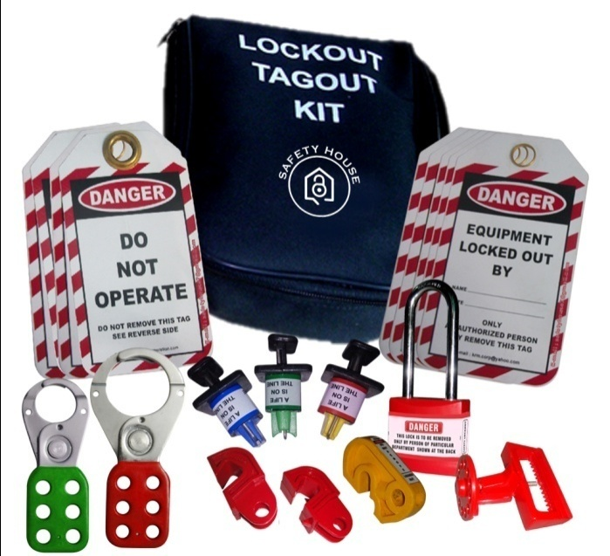
Safety House
BS EN ISO 9001 : 2008 CERTIFIED COMPANY
House of all Safety Products
CE Certified products
Item code - SH-LOTO-BASIC-KIT –Rs.1240/- MRP – Rs.2500/-
Lockout Pouch – 1 pc
MCB Lockout – Different Models – 5 pcs
Pin Type MCB Lockout – 3 pcs.
MCCB Lockout – 1 pc
Dielectric Hasp – Yellow – 1 pc
Lockout Tag – 10 pcs
Lockout Ties – 10 pcs
Vinyl coated Hasp – 2 pcs
Padlock – Long shackle – 1 pc
Keyring – 1 pcs
Writing pen – 1 pc
Add: 12/16, 3rd floor, Ashok Nagar, New Delhi-110018 (INDIA), Ph. : +91 11 2598 1265
M : +919999 656979, 99710 87519, E-mail : safetyhouse7@gmail.com, safetyhouse7@yahoo.com

Slide 47
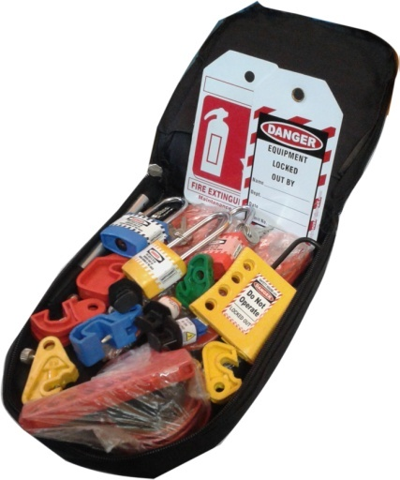
Safety House
BS EN ISO 9001 : 2008 CERTIFIED COMPANY
House of all Safety Products
CE Certified products
Item code - SH-LOTO-BASIC-KIT –Rs.1240/- MRP – Rs.2500/-
Lockout Pouch – 1 pc
MCB Lockout – Different Models – 5 pcs
Pin Type MCB Lockout – 3 pcs.
MCCB Lockout – 1 pc
Dielectric Hasp – Yellow – 1 pc
Lockout Tag – 10 pcs
Lockout Ties – 10 pcs
Vinyl coated Hasp – 2 pcs
Padlock – Long shackle – 2 pcs
Keyring – 1 pcs
Writing pen – 1 pc
Add: 12/16, 3rd floor, Ashok Nagar, New Delhi-110018 (INDIA), Ph. : +91 11 2598 1265
M : +919999 656979, 99710 87519, E-mail : safetyhouse7@gmail.com, safetyhouse7@yahoo.com

Slide 48
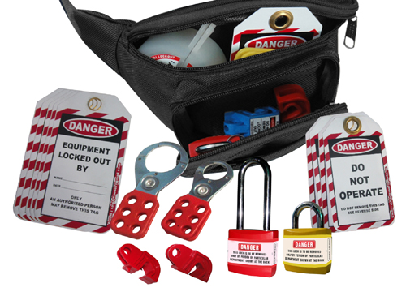
Safety House
BS EN ISO 9001 : 2008 CERTIFIED COMPANY
House of all Safety Products
CE Certified products
Item code - SH-LOTO-WP-BASIC-KIT- Rs.1090/-MRP- Rs.2200/-
Lockout Waist Pouch – 1 pc
MCB Lockout – Different Models – 5 pcs
Dielectric Hasp – Yellow – 1 pc
Lockout Tag – 10 pcs
Lockout Ties – 10 pcs
Vinyl coated Hasp – 2 pcs
Push Button Lockout – 1 pc
Padlock – Long shackle – 1 pc
Padlock – Regular shackle – 1 pc
Keyring – 2 pcs
Writing pen – 1 pc
Add: 12/16, 3rd floor, Ashok Nagar, New Delhi-110018 (INDIA), Ph. : +91 11 2598 1265
M : +919999 656979, 99710 87519, E-mail : safetyhouse7@gmail.com, safetyhouse7@yahoo.com

Slide 49
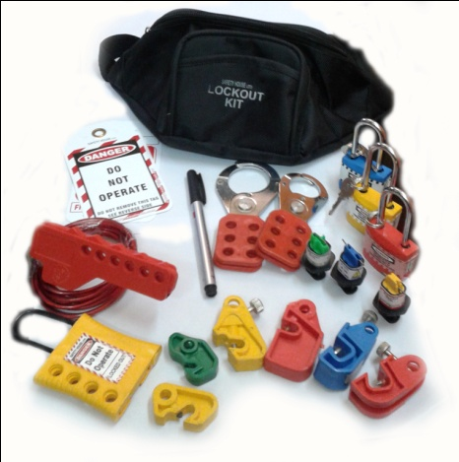
Safety House
BS EN ISO 9001 : 2008 CERTIFIED COMPANY
House of all Safety Products
CE Certified products
Item code - SH-LOTO-WP-BASIC-KIT- Rs.1090/-MRP- Rs.2200/-
Lockout Waist Pouch – 1 pc
MCB Lockout – Different Models – 5 pcs
Dielectric Hasp – Yellow – 1 pc
Lockout Tag – 10 pcs
Lockout Ties – 10 pcs
Vinyl coated Hasp – 2 pcs
Push Button Lockout – 1 pc
Padlock – Long shackle – 1 pc
Padlock – Regular shackle – 1 pc
Keyring – 2 pcs
Writing pen – 1 pc
Add: 12/16, 3rd floor, Ashok Nagar, New Delhi-110018 (INDIA), Ph. : +91 11 2598 1265
M : +919999 656979, 99710 87519, E-mail : safetyhouse7@gmail.com, safetyhouse7@yahoo.com

Slide 50
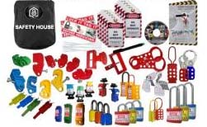
Safety House
BS EN ISO 9001 : 2008 CERTIFIED COMPANY
House of all Safety Products
CE Certified products
Item code - SH-MCB-LARGE-KIT – Rs.3490/- MRP-Rs.7100/-
Lockout Pouch – 1 pc
MCB Lockout – Different Models – 15 pcs
MCCB Lockout – 2 pcs
Pin Type MCB Lockout – 3 pcs
Tie Bar Lockout – 2 pcs
Dielectric Hasp – Yellow – 2 pcs
Double jaw Hasp – 2 pcs
6 hole dielectric Hasp – 1 pc
Labeled Hasp – 1 pcs
Lockout Tag – 10 pcs
Lockout Ties – 10 pcs
Vinyl coated Hasp – 2 pcs
Padlock – Long shackle – 3 pcs
Padlock – Regular shackle – 3 pcs
Small Padlocks – 3 pcs
Keyring – 6 pcs
Lockout Lables – 2 pcs
Writing pen – 1 pc
Lockout Book – 1 pc
Lockout CD presentation – 1 pc
Add: 12/16, 3rd floor, Ashok Nagar, New Delhi-110018 (INDIA), Ph. : +91 11 2598 1265
M : +919999 656979, 99710 87519, E-mail : safetyhouse7@gmail.com, safetyhouse7@yahoo.com

Slide 51
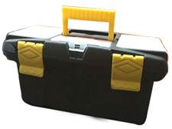
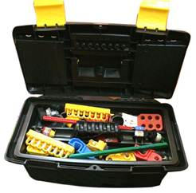
Safety House
BS EN ISO 9001 : 2008 CERTIFIED COMPANY
House of all Safety Products
CE Certified products
Item code - SH-LOTO-ELEC-BOX-S-Rs.1995/-MRP-4488/-
Lockout Box– 1 pc
MCB Lockout – Different Models – 5 pcs
Dielectric Hasp – Yellow – 1 pc
Lockout Tag – 2 pcs
Lockout Ties – 2 pcs
Vinyl coated Hasp – Small - 1 pcs
Vinyl coated Hasp – Bigl - 1 pcs
Push Button Lockout – 1 pc
Padlock – Long shackle – 1 pc
Padlock – Regular shackle – 1 pc
Keyring – 2 pcs
Writing pen – 1 pc
Screw Driver – 1 pc
Handle Lockout – 1 pc
Pin Type MCB Lockout – different models - 3 pcs
Add: 12/16, 3rd floor, Ashok Nagar, New Delhi-110018 (INDIA), Ph. : +91 11 2598 1265
M : +919999 656979, 99710 87519, E-mail : safetyhouse7@gmail.com, safetyhouse7@yahoo.com

Slide 52

Safety House
BS EN ISO 9001 : 2008 CERTIFIED COMPANY
House of all Safety Products
CE Certified products
Item code - SH-LOTO-ELEC-BOX-L-Rs.3415/-MRP-6830/-
Lockout Box– 1 pc
MCB Lockout – Different Models – 5 pcs
Dielectric Hasp – Yellow – 1 pc
Plug Lockout – Small
Electrical Bar Lockout – 1 set
LCB Lockout – 1 pc
Lockout Tag – 2 pcs
Lockout Ties – 2 pcs
Vinyl coated Hasp – Small - 1 pcs
Vinyl coated Hasp – Bigl - 1 pcs
Push Button Lockout – 1 pc
Padlock – Long shackle – 2 pc
Padlock – Regular shackle – 2 pc
Tie Bar Lockout – 1 pc.
Electrical Panel Lockout – Small Round – 1 pc
Electrical Panel Lockout – Small Square – 1 pc
Keyring – 2 pcs
Writing pen – 1 pc
Screw Driver – 1 pc
Handle Lockout – 1 pc
Pin Type MCB Lockout – different models - 3 pcs
Add: 12/16, 3rd floor, Ashok Nagar, New Delhi-110018 (INDIA), Ph. : +91 11 2598 1265
M : +919999 656979, 99710 87519, E-mail : safetyhouse7@gmail.com, safetyhouse7@yahoo.com

Slide 53

Safety House
BS EN ISO 9001 : 2008 CERTIFIED COMPANY
House of all Safety Products
CE Certified products
Item code - SH-ELEC-LARGE-KIT – Rs.4900/- MRP-Rs.9900/-
Lockout Station – 1 pc
Handle Lockout – 1 pc
MCB Lockout – Different Models – 5 pcs
MCCB Lockout – 1pc
Pin Type MCB Lockout – 3 pcs
Bar Lockout – 1 pc
Cylinder Lockout – yellow – 1 pc
Plug Lockout – Small – 1 pc
Push Button Lockout – 1 pc
Big Multipurpose cable Lockout – 1 pc
Scissor Cable Lockout – 1 pc
Round Cable Lockout – 1 pc
Dielectric Hasp – Yellow – 1 pc
Double jaw Hasp – 1 pc
6 hole dielectric Hasp – 1 pc
Labeled Hasp – 1 pcs
Lockout Tag – 2 pcs
Vinyl coated Hasp – 2 pcs
Padlock – Long shackle – 3 pcs
Padlock – Regular shackle – 3 pcs
Add: 12/16, 3rd floor, Ashok Nagar, New Delhi-110018 (INDIA), Ph. : +91 11 2598 1265
M : +919999 656979, 99710 87519, E-mail : safetyhouse7@gmail.com, safetyhouse7@yahoo.com

Slide 54

Safety House
BS EN ISO 9001 : 2008 CERTIFIED COMPANY
House of all Safety Products
CE Certified products
Item code - SH-ELEC-Box-KIT-Rs.3200/- MRP-7155/-
Gate Valve Lockout – 02 – 1 pc
Cylinder Lockout – 1 pc
Plug Lockout – Small – 1 pc
Plug Lockout – Large – 1 pc
Rack In Out Lockout Device– 1 pc
Labeled Hasp – 1 pcs
Lockout Tag – 5 pcs
Vinyl coated Hasp – 2 pcs
Padlock – Long shackle – 1 pc
Padlock – Regular shackle – 1 pc
Lockout Sign =- 1 pc
Bar Lockout – 1 set
MCB Lockout – 3 pcs
Pin Type MCB Lockout – 3 pcs
Lockout Book – 1 pc
Writing pen – 1 pc
Screw Driver – 1 pc
Lockout Big Box
Add: 12/16, 3rd floor, Ashok Nagar, New Delhi-110018 (INDIA), Ph. : +91 11 2598 1265
M : +919999 656979, 99710 87519, E-mail : safetyhouse7@gmail.com, safetyhouse7@yahoo.com

Slide 55

Safety House
BS EN ISO 9001 : 2008 CERTIFIED COMPANY
House of all Safety Products
CE Certified products
Item code - SH-Elect / MECH Mix Box-KIT-Rs.2670/-MRP-6007/-
Cylinder Lockout – 1 pc
Plug Lockout – Small – 1 pc
Plug Lockout – Large – 1 pc
6 hole dielectric Hasp – 1 pc
Bar Lockout – 1 set
Lockout Tag – 2 pcs
Vinyl coated Hasp – 2 pcs
Round type cable Lockout – 1 pc
OSHA Padlock – Long shackle – 3 pcs
MCB Lockout – 3 pcs
Rack In Out Lockout device – 1 pc
Lockout Sign = 1 pc
Lockout Big Box
Add: 12/16, 3rd floor, Ashok Nagar, New Delhi-110018 (INDIA), Ph. : +91 11 2598 1265
M : +919999 656979, 99710 87519, E-mail : safetyhouse7@gmail.com, safetyhouse7@yahoo.com

Slide 56

House of all Safety Products
CE Certified products
Item code – SH-JUMBO-Kit – Rs.12400/- MRP – 25000/-
Add: 12/16, 3rd floor, Ashok Nagar, New Delhi-110018 (INDIA), Ph. : +91 11 2598 1265
M : +919999 656979, 99710 87519, E-mail : safetyhouse7@gmail.com, safetyhouse7@yahoo.com

Slide 57
House of all Safety Products
CE Certified products
Item code – JUMBO Kit
Lockout Beg Red - 1 Pc
Padlock long shackle different color – 10 pc
Padlock Regular shackle different color – 10 pc
Lockout hasp small- 2 pc
Lockout hasp big - 2 Pc
Dielectric hasp 6 hole – 2 Pc
MCB different model – 10 Pc
Round cable lockout - 2 Pc
Lockout Rack cover in round – 2 Pc
Scissor cable lockout – 2 Pc
MCCB lockout round upper – 2 Pc
Breaker lockout kit – 2 pc
Writing Pen – 2 Pc
Lockout Book – 2 Pc
EPL small Square shape – 2 pc
Lockout Register – 2 Pc
De – Electric yellow hasp – 2 Pc
EPL Small round shape – 2 Pc
EPL Large round shape – 2 Pc
EPL Extra large square shape – 2 Pc
Lockout Keyring – 21 Pc
MCCB large circuit breaker lockout – 2 Pc
Lockout Cylinder yellow color – 2 Pc
Plug lockout large – 2 Pc
Mini pneumatic lockout device – 2 Pc
Scaffolding tag made of rewritable – 10 Pc
Scaffolding tag holder – 1 Pc
Lockout tag printed – 10 Pc
Lockout Pin different color – 6 Pc
Padlock Eye medium size – 20 Pc
Padlock Eye lrage size – 10 Pc
Electrical Handle lockout – 2 Pc
Tie bar circuit breaker lockout – 2 Pc
Lockout Push button – 2 Pc
Big multipurpose cable lockout – 2 Pc
Lockout Tag Hasp – 2 Pc
Add: 12/16, 3rd floor, Ashok Nagar, New Delhi-110018 (INDIA), Ph. : +91 11 2598 1265
M : +919999 656979, 99710 87519, E-mail : safetyhouse7@gmail.com, safetyhouse7@yahoo.com

Slide 58

House of all Safety Products
CE Certified products
Item code – SH-STANDARD-ELECTRICAL KIT – Rs.4300/- MRP Rs.8800/-
Lockout Red Pouch – 1 pc
Padlock long shackle different color – 6 Pc
Lockout 6 hole hasp – 2
Di-Electric Yellow hasp – 2 pc
Big Multipurpose cable lockout- 2 pc
Plug lockout small – 2 pc
Plug lockout Large – 2 pc
Lockout Pen – 1 pc
Lockout Pin different model – 3 pc
UCB different model – 11 pc
Lockout Pen – 1 pc
Lockout Tie – 10 pc
Electrical Panel lockout small- 2 pc
Electrical panel lockout Small square – 1 pc
Electrical pane lockout big square – 2 pc
Handel lockout – 1 pc
Lockout yellow cylinder – 1 pc
Scissor cable lockout – 2 pc
Lockout Tag – 10 pc
Add: 12/16, 3rd floor, Ashok Nagar, New Delhi-110018 (INDIA), Ph. : +91 11 2598 1265
M : +919999 656979, 99710 87519, E-mail : safetyhouse7@gmail.com, safetyhouse7@yahoo.com

Slide 59

House of all Safety Products
CE Certified products
Item code - SH-ELEC-STATION-LARGE-KIT – Rs.9500/- MRP – 19000/-
Add: 12/16, 3rd floor, Ashok Nagar, New Delhi-110018 (INDIA), Ph. : +91 11 2598 1265
M : +919999 656979, 99710 87519, E-mail : safetyhouse7@gmail.com, safetyhouse7@yahoo.com

Slide 60
House of all Safety Products
CE Certified products
Item code – SH-ELEC-STATION-LARGE-KIT
Lockout Red Station – 1 pc
Padlock long shackle diffrent color – 6 Pc
Padlock Regular shackle – 6 pc
Lockout 6 hole hasp – 2
Di-Electric Yellow hasp – 2 pc
Big Multipurpose cable lockout- 2 pc
Lockout big hasp red color – 3 pc
Lockout Small hasp – 3 pc
Lockout lable hasp – 2 pc
Round cble lockout - 2 pc
Lockout Pin different model – 6 pc
UCB different model – 11 pc
Lockout Rack cover in round shape – 2 pc
Electrical Panel lockout small round- 1 pc
Electrical panel lockout Small square – 1 pc
Electrical panel lockout big round – 1 pc
Electrical pane lockout big square – 1 pc
Large circuit breaker lockout – 1 pc
Large circuit breaker lockout round upper – 1 pc
Lockout Book – 1 pc
Lockout Register – 1 pc
Bar lockout – 2 pc
Push button lockout – 1 pc
Lockout Scaffold tag – 1 pc
Lockout Scaffold Tag holder – 1 pc
Lockout padlock Eye Buffer – 1 pc
Padlock eye small / large size - pc
Handle lockout – 1 pc
Lockout Tag – 2 pc
Tie bar lockout - 2 pc
Scissor cable lockout – 2 pc
Add: 12/16, 3rd floor, Ashok Nagar, New Delhi-110018 (INDIA), Ph. : +91 11 2598 1265
M : +919999 656979, 99710 87519, E-mail : safetyhouse7@gmail.com, safetyhouse7@yahoo.com

Slide 61

House of all Safety Products
CE Certified products
Item code – Large Circuit Breaker Lockout Kit – Rs.3300/- MRP – 7000/-
Yellow pouch - 1
Padlock long shackle diffrent color – 3 Pc
Padlock regular shackle different – 6 PC
Lockout Bravo lock – 3 pc
Lockout 6 hole hasp – 2 PC
Di-Electric Yellow hasp – 2 pc
Lockout big hasp red color – 1 pc
Lockout Small hasp – 1 pc
Lockout Pin different model – 3 pc
UCB different model – 10 pc
Lockout Tag – 10 pc
Lockout Tie – 10 pc
Lockout Pen – 1 pc
LCB Lockout – 2 pc
Lockout Book – 1 pc
Lockout Bar – 2 pc
Lockout Keyring – 3 pc
Add: 12/16, 3rd floor, Ashok Nagar, New Delhi-110018 (INDIA), Ph. : +91 11 2598 1265
M : +919999 656979, 99710 87519, E-mail : safetyhouse7@gmail.com, safetyhouse7@yahoo.com

Slide 62
House of all Safety Products
CE Certified products
Item code - SH-ELEC-LARGE-KIT – Rs. 2390/-MRP-5378/-
Lockout Red Bag – 1 pc
Padlock long shackle yellow red color – 3 Pc
Lockout Small hasp – 4 pc
UCB Yellow lockout – 1 pc
Lockout handle – 3 pc
Lockout push button – 1 pc
Lockout Tag – 10 pc
Round cable lockout – 3 pc
Big Multipurpose lockout – 2 pc
Rack cover lockout – 1 pc
Add: 12/16, 3rd floor, Ashok Nagar, New Delhi-110018 (INDIA), Ph. : +91 11 2598 1265
M : +919999 656979, 99710 87519, E-mail : safetyhouse7@gmail.com, safetyhouse7@yahoo.com

Slide 63

House of all Safety Products
CE Certified products
Item code – SH-HANDY-ELECTRICAL KIT – Rs. 1600/- MRP-3500/-
Lockout Red Bag – 1 pcs
Padlock small shackle – 1 Pcs
Di-Electric Padlock – 1 pcs
Lockout Small hasp – 4 pcs
MCB Lockout Different Model - 5 pcs
Lockout Tag – 10 pcs
Tie Bar Lockout – 1 pcs
Pin In / Out Type Lockout – 3 pcs
Writing Pen – 1 pcs
Di –Electric 6 hole hasp – 1 pcs
Snap on Breaker Lockout – 1 pcs
Add: 12/16, 3rd floor, Ashok Nagar, New Delhi-110018 (INDIA), Ph. : +91 11 2598 1265
M : +919999 656979, 99710 87519, E-mail : safetyhouse7@gmail.com, safetyhouse7@yahoo.com

Slide 64

House of all Safety Products
CE Certified products
Item code – SH-ELECTRICIAN-LOTO-KIT – Rs. 2070/- MRP-4658/-
Lockout Yellow Pouch – 1 pcs
Di – Electric Padlock – 3 Pcs
MCB Lockout Different Model - 7 pcs
Lockout Tag – 10 pcs
Scissor Lockout – 1 pcs
Writing Pen – 1 pcs
Screw Driver - 1 pcs
Di –Electric 6 hole hasp – 3 pcs
Lockout fuse – 1 pcs
Lockout Tie – 10 pcs
Add: 12/16, 3rd floor, Ashok Nagar, New Delhi-110018 (INDIA), Ph. : +91 11 2598 1265
M : +919999 656979, 99710 87519, E-mail : safetyhouse7@gmail.com, safetyhouse7@yahoo.com

Slide 65

House of all Safety Products
CE Certified products
Item code – SH-ELECTRICAL-PERSONAL-KIT – Rs.2700/- MRP – 5400/-
Lockout Belt Pouch – 1 pcs
Di – Electric Padlock – 3 Pcs
MCB Lockout Different Model - 7 pcs
Lockout Tag – 10 pcs
Round cable Lockout – 1 pcs
Writing Pen – 1 pcs
Screw Driver - 1 pcs
Di –Electric 6 hole hasp – 1 pcs
Lockout fuse – 1 pcs
Lockout Hasp small – 1 pcs
Di – Electric Yellow Hasp – 1 pcs
Electrical Handle Lockout – 1 pcs
Push Button Lockout – 1 pcs
Loto Book – 1 pcs
Circuit Breaker Lockout – 1 pcs
Rackout Cover – 1 pcs
Pin Different model – 3 pcs
Add: 12/16, 3rd floor, Ashok Nagar, New Delhi-110018 (INDIA), Ph. : +91 11 2598 1265
M : +919999 656979, 99710 87519, E-mail : safetyhouse7@gmail.com, safetyhouse7@yahoo.com

